Slide 1
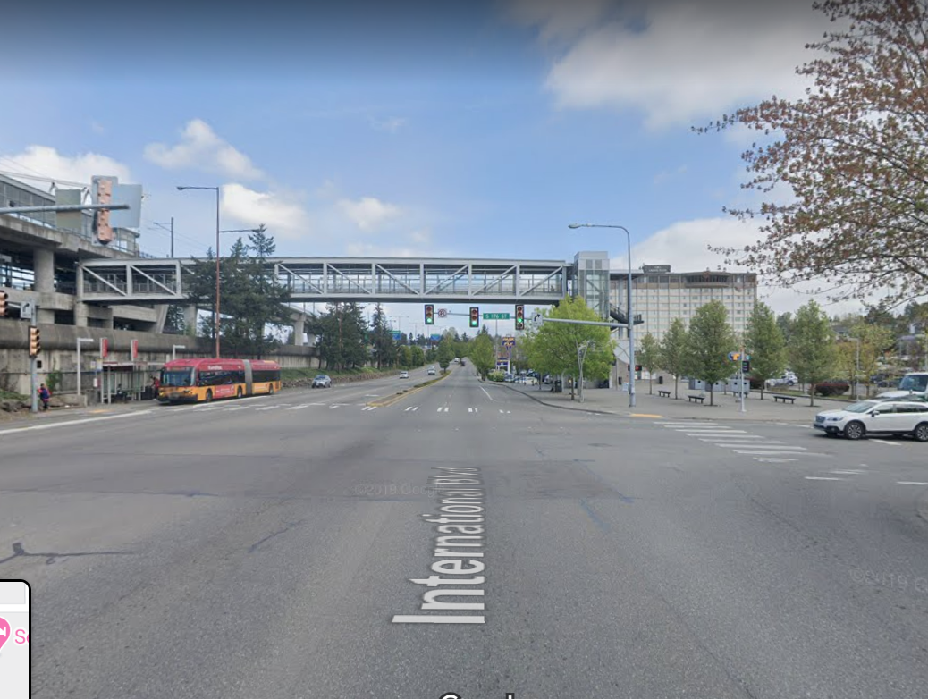
Local Road Safety Plan
June 17th, 2021
Mason Giem
Public Works Programs Coordinator
Eric Widstrand, PE, PTOE
Northwest Regional Traffic Engineering Director
Toole Design

Slide 2
PRESENTATION OVERVIEW
PURPOSE OF PRESENTATION
To provide a review of the purpose and content of the Local Road Safety Plan. The schedule, metrics for project selection and outreach plan will also be reviewed.
WHY IS THIS ISSUE IMPORTANT?
Inform the committee on project status.
The projects will increase safety along key corridors in SeaTac.
The valuable input from the sidewalk committee will help inform decisions.
Inform the committee on how input will be gathered from the public and other stakeholders.
Notes:
Note: Remove all text from this page that is not relevant to your project. Remove descriptions in red.
If you need to add additional text, duplicate this slide to continue your list.
HEADER TITLE ALL CAPS AT FONT SIZE 20 CALIBRI (BODY), BOLD
Insert text at font size 18 Calibri (Body)

Slide 3
Citywide Local Road Safety Plan and Pedestrian Crossings of International Boulevard
The Scope: Two distinct, but interrelated safety programs for the City of SeaTac
Pedestrian safety crossing improvement projects on the International Boulevard corridor, from South 152nd Street to South 216th Street.
Preparing a citywide Local Road Safety Plan that will propose strategies and measures to improve safety for all modes of transportation.
Notes:
HEADER TITLE ALL CAPS AT FONT SIZE 20 CALIBRI (BODY)
Insert text at font size 18 Calibri (Body)
Duplicate this slide as many times as you need it.

Slide 4
Citywide Local Road Safety Plan
What is a Local Road Safety Plan?
Scope determined by WSDOT criteria
A data-driven analysis and prioritization of an agency’s roadways for traffic safety, based on top crash types
Considers all modes of travel in analysis (motor vehicle, pedestrian, bicyclist)
Notes:
HEADER TITLE ALL CAPS AT FONT SIZE 20 CALIBRI (BODY)
Insert text at font size 18 Calibri (Body)
Duplicate this slide as many times as you need it.

Slide 5
Citywide Local Road Safety Plan
Why complete a Local Road Safety Plan?
To understand traffic safety issues (for all modes of travel) and determine safety priorities
To prioritize projects and be ready for funding
To create a more context-based safety program to better address safety and spend limited funds
Notes:
HEADER TITLE ALL CAPS AT FONT SIZE 20 CALIBRI (BODY)
Insert text at font size 18 Calibri (Body)
Duplicate this slide as many times as you need it.

Slide 6
Citywide Local Road Safety Plan
Project Timeline
August 2020- August 2021 Phase 1, Pedestrian Crossings along International Boulevard.
December 2020 – December 2021 Phase 2, Local Road Safety Plan
Notes:
HEADER TITLE ALL CAPS AT FONT SIZE 20 CALIBRI (BODY)
Insert text at font size 18 Calibri (Body)
Duplicate this slide as many times as you need it.

Slide 7
Local Road Safety Program Components
WSDOT LRSP Step | SeaTac Crash Analysis Report Element
1. Analyze crash data to identify priorities | Descriptive analysis and crash tree analysis
2. Analyze individual KSI crashes to identify risk factors
3. Select most common or critical risk factors
4. Analyze roadway network for presence of factors | Screen roadway network and count number of high-risk factors present
5. Create a prioritized list of roadway locations where factors are present | Prioritized roadway locations (will include outreach input)
6. Identify countermeasures to address prioritized locations | Develop methodology for countermeasures and selection. Select
7. Develop a prioritized list of projects | Prioritized list of projects
Note: Shaded cells indicate what elements have been completed.
WSDOT LRSP Step | SeaTac Crash Analysis Report Element
Analyze crash data to identify priorities | Descriptive analysis and crash tree analysis
Analyze individual KSI crashes to identify risk factors
Select most common or critical risk factors
Analyze roadway network for presence of factors | Screen roadway network and count number of high risk factors present
Create a prioritized list of roadway locations where factors are present | Prioritized roadway locations
Identify countermeasures to address prioritized locations | Develop methodology for countermeasures and selection. Select
Develop a prioritized list of projects | Prioritized list of projects
Note: Red cells indicate what elements have been completed and are summarized in this memo.
Notes:
STAFF – USE THIS FOR COUNCIL]
[Staff, please select potential actions from list or add a different action. Remove what is not relevant!]
HEADER TITLE ALL CAPS AT FONT SIZE 20 CALIBRI (BODY), BOLD
Insert text at font size 18 Calibri (Body)

Slide 8
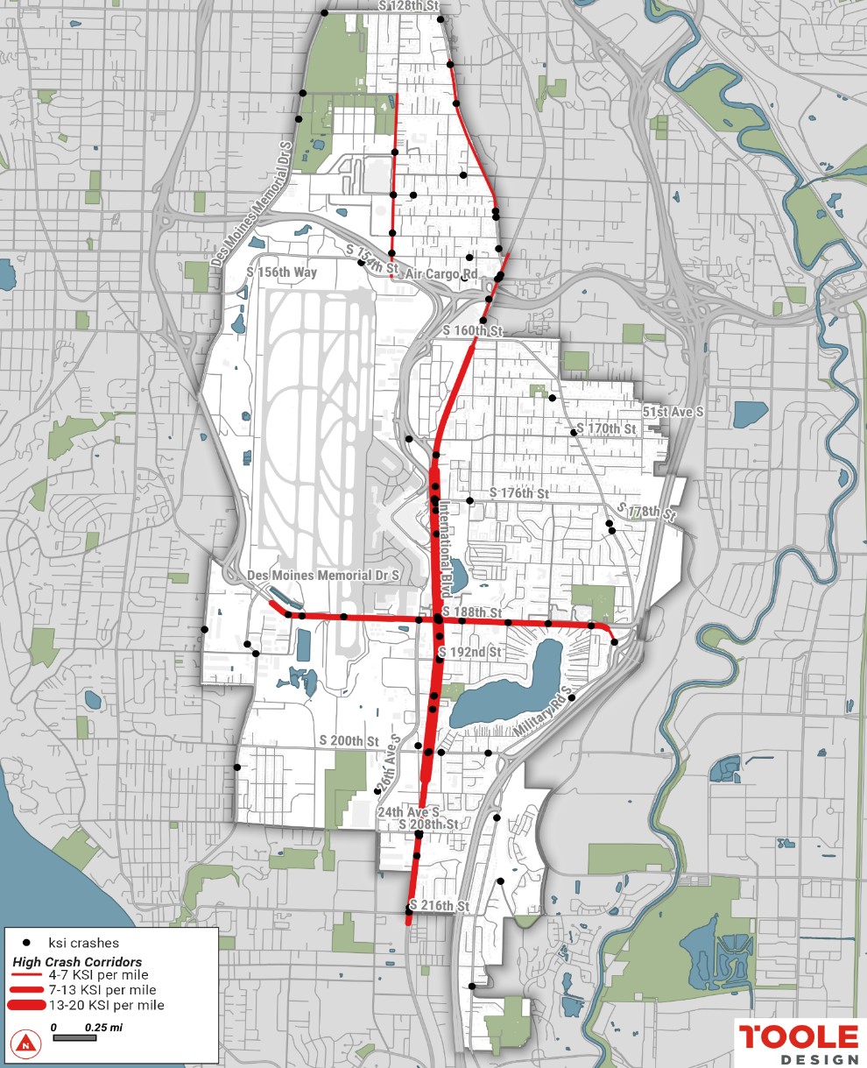
High Crash Corridors
Notes:
IB, S 188th St, Military Rd, 24th Ave S

Slide 9
Countermeasure Development Methodology
Review Potential Countermeasures from the Following Sources
Crash Typologies to Analyze
Countermeasures funded in recent years through WSDOT’s LRSP
Washington’s 2019 Target Zero Plan
FHWA Proven Safety Countermeasures
NCHRP 926 – Guidance to Improve Pedestrian and Bicyclist Safety at Intersections
Other well-rated countermeasures from the Crash Modification Clearinghouse
Signalized Intersections along Principal Arterials
Vehicle proceeding straight hits pedestrian
Vehicle proceeding straight hits fixed object
Notes:
STAFF – USE THIS FOR COUNCIL]
[Staff, please select potential actions from list or add a different action. Remove what is not relevant!]
HEADER TITLE ALL CAPS AT FONT SIZE 20 CALIBRI (BODY), BOLD
Insert text at font size 18 Calibri (Body)

Slide 10
Outreach Plan
Milestone Activities and Dates
Stakeholder Interviews – ongoing (10 stakeholder interviews completed, 4 remaining)
June 17 – Present project at Sidewalk Committee Meeting
Late June – Begin Virtual Focus Groups (hold 4 meetings)
June 24 – Launch web-based survey, remain active for 60 days
August – Present outreach results at Sidewalk Committee Meeting
Notes:
Focus groups – parents/schools, multi-family housing residents, business groups, sidewalk cmte

Slide 11
Citywide Local Road Safety Plan
QUESTIONS?
Notes:
STAFF – USE THIS FOR COUNCIL]
[Staff, please select potential actions from list or add a different action. Remove what is not relevant!]
HEADER TITLE ALL CAPS AT FONT SIZE 20 CALIBRI (BODY), BOLD
Insert text at font size 18 Calibri (Body)

Slide 12
Citywide Local Road Safety Plan
Thank you
Notes:
HEADER TITLE ALL CAPS AT FONT SIZE 20 CALIBRI (BODY)
Insert text at font size 18 Calibri (Body)
Duplicate this slide as many times as you need it.

