Slide 1
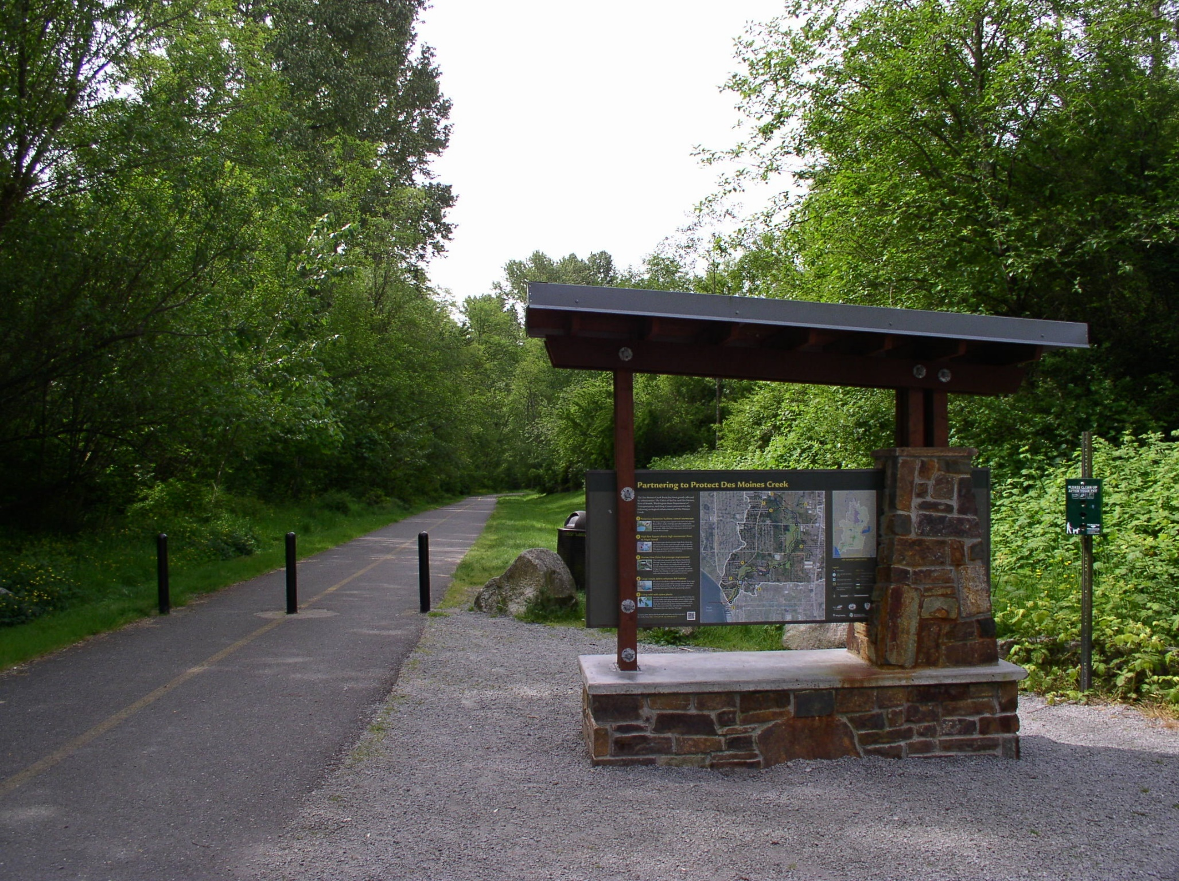
Regular City Council Meeting Property Acquisition for Des Moines Creek Park
March 9, 2021

Slide 2
PRESENTATION OVERVIEW
PURPOSE OF PRESENTATION
Approving Ordinance authorizing the City Manager to enter into a Contract with the Washington State Department of Transportation for the purchase of an 8-acre surplus land adjacent to and expanding Des Moines Creek Park and amend the 2021-2022 budget to provide $141,765.15 for an interest and principal payment in 2022.
WHY IS THIS ISSUE IMPORTANT?
Provides price certainty for the City and WSDOT.
Allows for possession and use of the entire site upon execution of the agreement.
Opportunity to add 8-acres of forested upland to Des Moines Creek Park and relocate trailhead.
Notes:
Note: Remove all text from this page that is not relevant to your project. Remove descriptions in red.
If you need to add additional text, duplicate this slide to continue your list.
HEADER TITLE ALL CAPS AT FONT SIZE 20 CALIBRI (BODY), BOLD
Insert text at font size 18 Calibri (Body)

Slide 3
BACKGROUND
Since 2018, the City of SeaTac has expressed an interest in acquiring approximately 8-acres of forested WSDOT surplus land adjacent to Des Moines Creek Park.
Expands open space to allow for an improved trail system.
New trailhead to include education and outreach elements, recreation amenities, safer ingress and egress and expand capacity.
Preserves high value conservation property adjacent to one of the City’s salmon bearing streams.
Listed in PROS Plan to increase recreation opportunities and trails.
Notes:
Note: Remove all text from this page that is not relevant to your project. Remove descriptions in red.
If you need to add additional text, duplicate this slide to continue your list.
HEADER TITLE ALL CAPS AT FONT SIZE 20 CALIBRI (BODY), BOLD
Insert text at font size 18 Calibri (Body)

Slide 4
BACKGROUND
In 2019, City Council authorized staff to pursue grant funding opportunities.
To begin formalized discussion with WSDOT regarding the acquisition of the subject property.
Secured $3.29M to date for acquisition purposes.
Additional $1.1M to be decided in 2021 if awarded through Conservation Future Tax Levy grant.
Notes:
Note: Remove all text from this page that is not relevant to your project. Remove descriptions in red.
If you need to add additional text, duplicate this slide to continue your list.
HEADER TITLE ALL CAPS AT FONT SIZE 20 CALIBRI (BODY), BOLD
Insert text at font size 18 Calibri (Body)

Slide 5
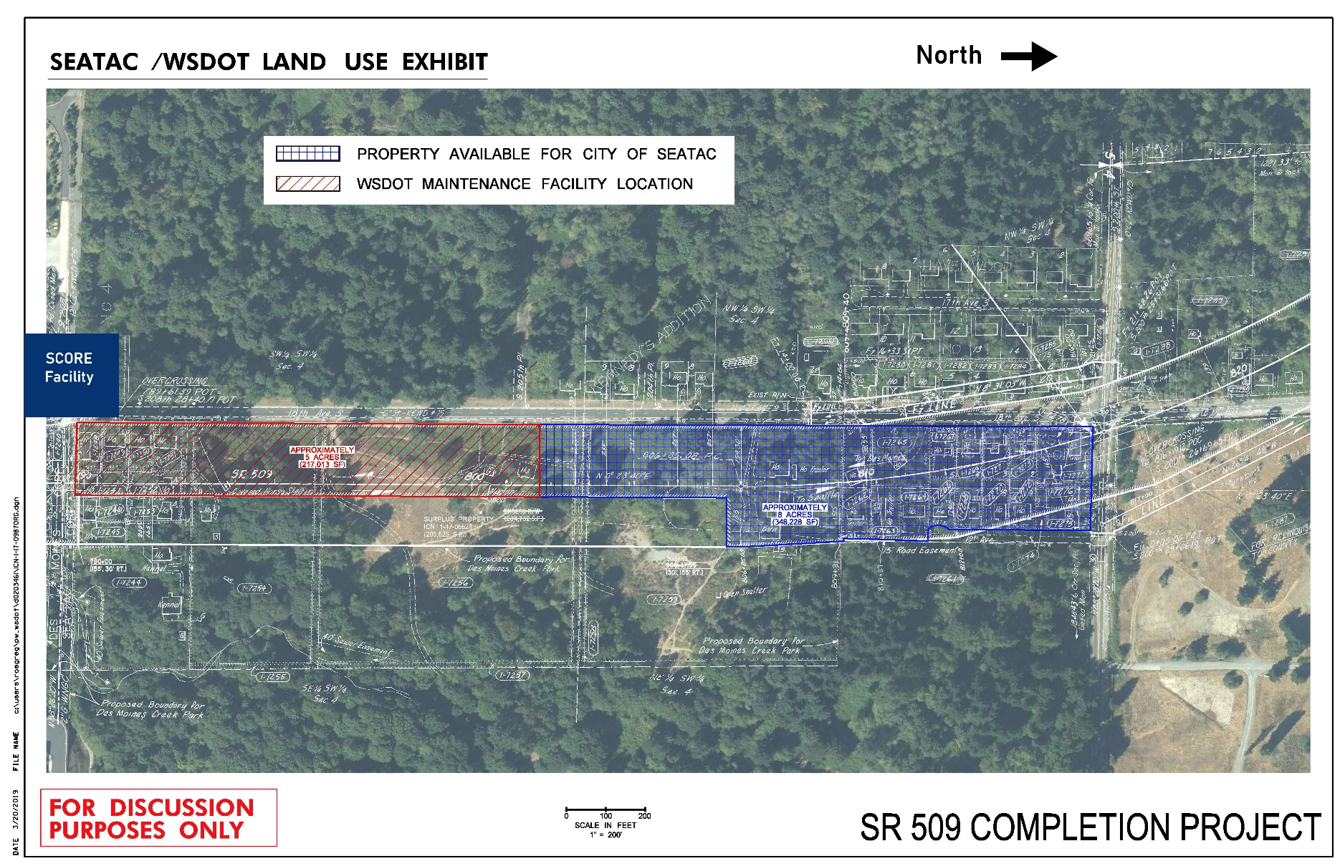
MAP OF PROPERTY
18th Avenue S.
S. 200th Street
Notes:
Note: Remove all text from this page that is not relevant to your project. Remove descriptions in red.
If you need to add additional text, duplicate this slide to continue your list.
HEADER TITLE ALL CAPS AT FONT SIZE 20 CALIBRI (BODY), BOLD
Insert text at font size 18 Calibri (Body)

Slide 6
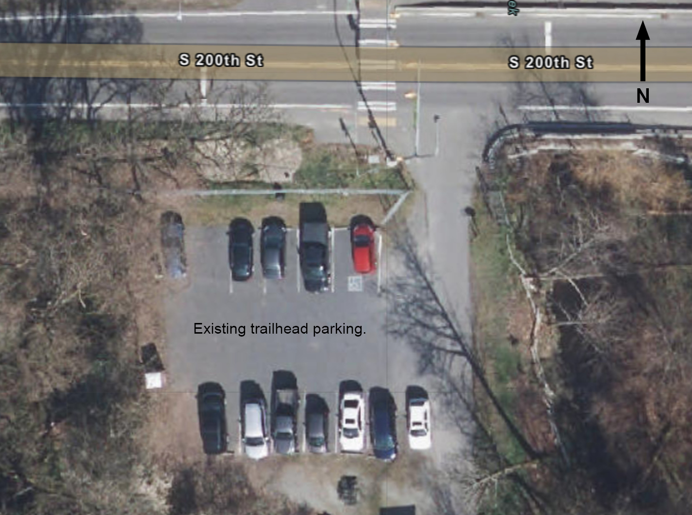
EXISTING TRAILHEAD
Notes:
Note: Remove all text from this page that is not relevant to your project. Remove descriptions in red.
If you need to add additional text, duplicate this slide to continue your list.
HEADER TITLE ALL CAPS AT FONT SIZE 20 CALIBRI (BODY), BOLD
Insert text at font size 18 Calibri (Body)

Slide 7
CURRENT FUNDING SOURCES
2019 King County Conservation Futures Grant | $1.1 M
City Matching Requirement | $1.1 M (403 Fund)
Proceeds from sales of Conservation Property | $90,000
2020 King Conservation Futures Grant | $0.5 M
City Matching Requirement | $0.5 M
TOTAL FUNDING | $3.29M
A third party, independent appraised value at $5.2M to $5.8M ($15-$16.50 per sqft) with the purchase price of $5.5M ($15.79 per sqft) .
Notes:
Note: Remove all text from this page that is not relevant to your project. Remove descriptions in red.
If you need to add additional text, duplicate this slide to continue your list.
HEADER TITLE ALL CAPS AT FONT SIZE 20 CALIBRI (BODY), BOLD
Insert text at font size 18 Calibri (Body)

Slide 8
APPROACHES ON ACQUIRING SUBJECT PROPERTY
Purchase portions of the 8-acres over time as funding becomes available or;
Enter into a purchase and sales contract for the entire 8-acres
Notes:
Note: Remove all text from this page that is not relevant to your project. Remove descriptions in red.
If you need to add additional text, duplicate this slide to continue your list.
HEADER TITLE ALL CAPS AT FONT SIZE 20 CALIBRI (BODY), BOLD
Insert text at font size 18 Calibri (Body)

Slide 9
BENEFITS OF ENTERING INTO CONTRACT
Provides price certainty for the City and WSDOT;
Purchase of a single large parcel is less expensive on a per sqft basis than dividing it up and purchasing several small parcels;
City can quickly secure its interest in the property;
Allows for possession and use of the entire site upon execution of the agreement;
Simplifies the administrative processes moving forward; and
Improve grant funding opportunities by demonstrating long term commitment.
Notes:
Note: Remove all text from this page that is not relevant to your project. Remove descriptions in red.
If you need to add additional text, duplicate this slide to continue your list.
HEADER TITLE ALL CAPS AT FONT SIZE 20 CALIBRI (BODY), BOLD
Insert text at font size 18 Calibri (Body)

Slide 10
Funding Summary
Funding Source | 2020 | 2021 | 2022 | Totals
KCCF Grant | $1,100,000 | $500,000 | $1,105,000 | $2,705,000
City (403) | $1,100,000 |  |  | $1,100,000
City (301) |  | $500,000 | $1,105,000 | $1,605,000
City (Property Sales) | $90,000 |  |  | $90,000
Annual Payment | $2,290,000 | $1,000,000 | $2,210,000 | $5,500,000*
Notes:
Remove red text

Slide 11
COMMITTEE REVIEW & RECOMMENDATIONS
Transportation and Public Works Committee, August 9, 2019
Parks and Recreation Committee, June 6, 2019
Parks and Recreation Committee, February 6, 2020
Parks and Recreation Committee, October 10, 2020
Item was presented to Committee and recommended forwarding item to City Council.
Notes:
Note: Remove all text from this page that is not relevant to your project. Remove descriptions in red.
If you need to add additional text, duplicate this slide to continue your list.
HEADER TITLE ALL CAPS AT FONT SIZE 20 CALIBRI (BODY), BOLD
Insert text at font size 18 Calibri (Body)

Slide 12
STAFF RECOMMENDATION
Opportunity to add 8-acres of forested upland to Des Moines Creek Park;
Funding will be without adversely impacting other programs and priorities;
City Council has already authorized the purchase of up to $2.2M worth of the subject parcel;
Benefit residents and visitors to the park;
Preserve valuable habitat adjacent to one of our salmon bearing streams; and
Continue to secure Grants through King County Conservation Futures Tax Levy.
Notes:
Note: Remove all text from this page that is not relevant to your project. Remove descriptions in red.
If you need to add additional text, duplicate this slide to continue your list.
HEADER TITLE ALL CAPS AT FONT SIZE 20 CALIBRI (BODY), BOLD
Insert text at font size 18 Calibri (Body)

Slide 13
POTENTIAL COUNCIL ACTION
Staff is seeking City Council authorization for the City Manager to complete negotiations with WSDOT and enter into a contract for the purchase and sale of an 8-acre piece of property.
Notes:
Note: Remove all text from this page that is not relevant to your project. Remove descriptions in red.
If you need to add additional text, duplicate this slide to continue your list.
HEADER TITLE ALL CAPS AT FONT SIZE 20 CALIBRI (BODY), BOLD
Insert text at font size 18 Calibri (Body)

Slide 14
Questions?
Notes:
Note: Remove all text from this page that is not relevant to your project. Remove descriptions in red.
If you need to add additional text, duplicate this slide to continue your list.
HEADER TITLE ALL CAPS AT FONT SIZE 20 CALIBRI (BODY), BOLD
Insert text at font size 18 Calibri (Body)

