Slide 1
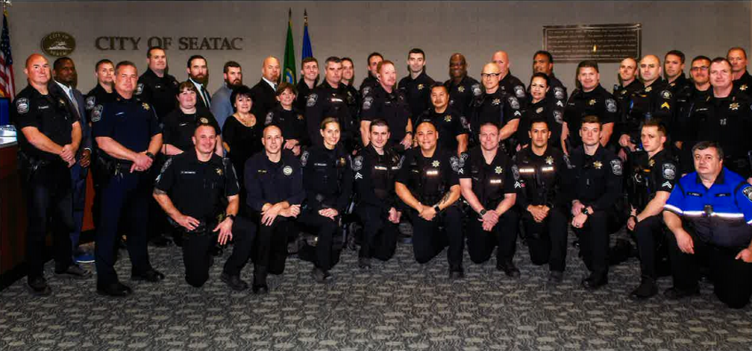
OVERVIEW OF SEATAC POLICE 2020

Slide 2
Reduce crime and improve the community’s sense of security
Through quick response, thorough investigations and thoughtful use of resources, we will instill confidence that SeaTac is a safe community in which to live, work and play.
Improve traffic safety by reducing impaired and unsafe driving behaviors and traffic collisions
Through enforcement, education, engineering and problem solving, work collaboratively with other city departments to reduce traffic collisions, moving violations and parking infractions.
Community Engagement
Encourage relationships and develop education programs that produce positive police interactions and sustain the public’s trust.
Support City Operations
Support City wide efforts to reduce the impact of residences and businesses that negatively impact City resources.
Support our People
Hire, train and mentor highly qualified, service minded people, while providing for each individual’s long-term safety, health and wellness.
2021 SEATAC POLICE DEPARTMENT GOALS

Slide 3
NATIONAL INCIDENT-BASED REPORTING SYSTEM, “NIBRS”
1929 – FBI instituted the Uniform Crime Reporting “UCR” method of collecting crime statistics. The Summary UCR method historically recorded and reported only the most serious offense committed in an incident, even though the incident could have involved multiple offenses.
1991 – the FBI initiated NIBRS to improve the overall quality of law enforcement crime data and set a date of 2021 for all agencies to be converted to the new method.
2018- the King County Sheriff’s Office instituted a new computer program in order to comply with the NIBRS mandate.
Notes:
Note: Remove all text from this page that is not relevant to your project. Remove descriptions in red.
If you need to add additional text, duplicate this slide to continue your list.
HEADER TITLE ALL CAPS AT FONT SIZE 20 CALIBRI (BODY), BOLD
Insert text at font size 18 Calibri (Body)

Slide 4
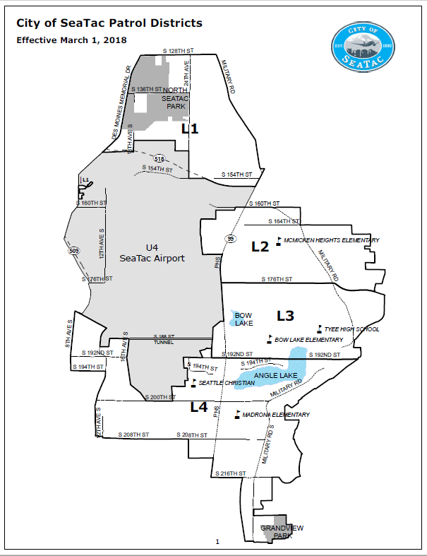
SeaTac Patrol Districts
Notes:
Remove slide if it is not necessary
HEADER TITLE ALL CAPS AT FONT SIZE 20 CALIBRI (BODY), BOLD
Insert text at font size 16-18 Calibri (Body)

Slide 5
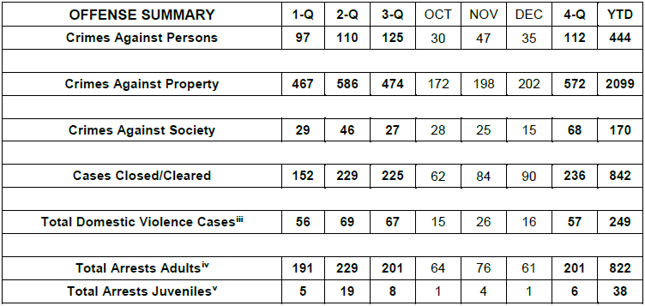
2020 CRIME CATEGORY TOTALS
Notes:
Remove slide if it is not necessary
HEADER TITLE ALL CAPS AT FONT SIZE 20 CALIBRI (BODY), BOLD
Insert text at font size 16-18 Calibri (Body)

Slide 6
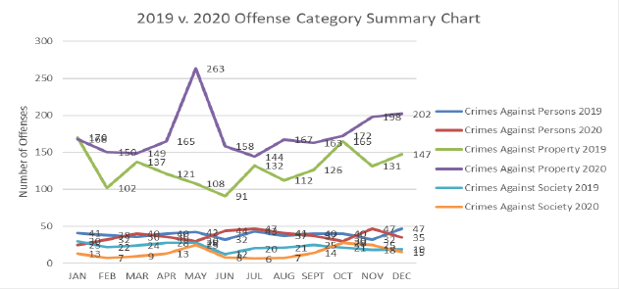
CRIME CATEGORIES 2019 VS 2020
Notes:
Remove slide if it is not necessary
HEADER TITLE ALL CAPS AT FONT SIZE 20 CALIBRI (BODY), BOLD
Insert text at font size 16-18 Calibri (Body)

Slide 7
CRIMES AGAINST PERSON STATS 2019 VS 2020
Offense | 2019 | 2020 | Changes
Aggravated Assault | 59 | 80 | +21
Simple Assault | 206 | 189 | -17
Intimidation | 81 | 58 | -23
Homicide | 4 | 6 | +2
Human Trafficking | 4 | 1 | -3
Kidnapping | 5 | 4 | -1
Sex Offenses | 52 | 37 | -15
No Contact Order Violations | Not Reported | 69 | 0
Total | 378 | 444 | +66
Notes:
Remove slide if it is not necessary
HEADER TITLE ALL CAPS AT FONT SIZE 20 CALIBRI (BODY), BOLD
Insert text at font size 16-18 Calibri (Body)

Slide 8
PROPERTY CRIMES STATS 2019 VS 2020
Offense | 2019 | 2020 | Changes
Commercial Burglary | 85 | 96 | +11
Residential Burglary | 73 | 104 | +31
Fraud | 148 | 228 | +80
Destruction/Damage/Vandalism of Property | 158 | 361 | +203
Larceny | 667 | 844 | +177
Motor Vehicle Theft | 317 | 364 | +47
Robberies | 59 | 58 | -1
Other | 0 | 44 | +44
Total | 1,507 | 2,099 | +592
Notes:
Remove slide if it is not necessary
HEADER TITLE ALL CAPS AT FONT SIZE 20 CALIBRI (BODY), BOLD
Insert text at font size 16-18 Calibri (Body)

Slide 9
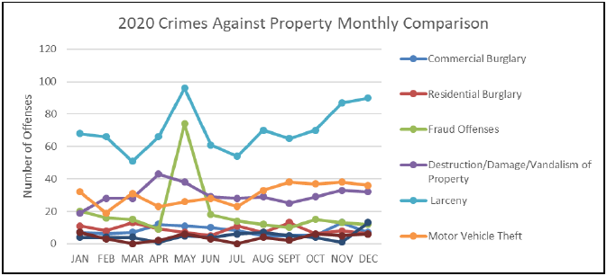
BREAKDOWN OF DIFFERENT PROPERTY OFFENSES
Notes:
Remove slide if it is not necessary
HEADER TITLE ALL CAPS AT FONT SIZE 20 CALIBRI (BODY), BOLD
Insert text at font size 16-18 Calibri (Body)

Slide 10
CRIMES AGAINST SOCIETY STATS 2019 VS 2020
Offense | 2019 | 2020 | Changes
Drugs/Narcotics Offenses | 209 | 103 | -106
Prostitution Offenses | 29 | 29 | 0
Weapon Law Violations | 33 | 38 | +5
Other Crimes Against Society | 0 | 0 | 0
Total | 271 | 170 | -101
Notes:
Remove slide if it is not necessary
HEADER TITLE ALL CAPS AT FONT SIZE 20 CALIBRI (BODY), BOLD
Insert text at font size 16-18 Calibri (Body)

Slide 11
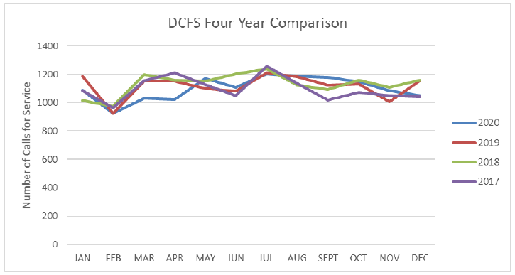
4 YEAR COMPARISON DCFS
Notes:
Remove slide if it is not necessary
HEADER TITLE ALL CAPS AT FONT SIZE 20 CALIBRI (BODY), BOLD
Insert text at font size 16-18 Calibri (Body)

Slide 12
2020 SeaTac PD RESPONSE TIMES
AVG Response Time | 1-Q | 2-Q | 3-Q | OCT | NOV | DEC | 4-Q
Critical Dispatch X= | 4.43 | 4.13 | 3.96 | 3.70 | 4.63 | 3.08 | 3.84
Immediate Dispatch 1= | 8.16 | 8.60 | 8.13 | 8.21 | 6.69 | 9.31 | 8.10
Prompt Dispatch 2= | 11.90 | 10.97 | 12.08 | 10.19 | 10.45 | 10.05 | 10.23
Routine Dispatch 3= | 30.20 | 24.54 | 28.36 | 25.88 | 26.32 | 27.41 | 26.53
Notes:
Remove slide if it is not necessary
HEADER TITLE ALL CAPS AT FONT SIZE 20 CALIBRI (BODY), BOLD
Insert text at font size 16-18 Calibri (Body)

Slide 13
KING COUNTY DE-INTENSIFICATION SHELTERS IN SEATAC
Quality Inn
April 2020 it was announced the Quality Inn in SeaTac would begin operating as a homeless shelter
Significant jump in crime in the area from when it was a hotel
Sleep Inn
January 1, 2021 residents of shelter relocated to Sleep Inn from Quality Inn
Lease is supposed to be until mid-year
Calls up 300+% from last year at the same location, for same time period (Jan/Feb)
Visible increase in Panhandling in the medians and corners of major intersections
Notes:
HEADER TITLE ALL CAPS AT FONT SIZE 20 CALIBRI (BODY)
Insert text at font size 18 Calibri (Body)
Duplicate this slide as many times as you need it.

Slide 14
NATIONAL CRIME TRENDS FIRST 6 MONTHS OF 2020
Violent Crimes (first six months of 2020 vs first six months of 2019)
Rape offenses decreased 17.8%
Robbery offenses were down 7.1%
Murder and non-negligent manslaughter offenses increased 14.8%
Aggravated assault offenses were up 4.6%.
Property Crimes (first six months of 2020 vs first six months of 2019)
Offenses declined 7.8%
Larceny thefts were down 9.9%
Burglaries decreased 7.8%
Motor vehicle thefts increased 6.2%.
FBI National Press Release
Notes:
HEADER TITLE ALL CAPS AT FONT SIZE 20 CALIBRI (BODY)
Insert text at font size 18 Calibri (Body)
Duplicate this slide as many times as you need it.

Slide 15
TRI COUNTY COMPARISON OF CRIME RATES
FIRST 6 MONTHS OF BOTH 2019 AND 2020
Notes:
HEADER TITLE ALL CAPS AT FONT SIZE 20 CALIBRI (BODY)
Insert text at font size 18 Calibri (Body)
Duplicate this slide as many times as you need it.

Slide 16
RISE IN CRIME IN REGION IN 2020 OVER 2019 - NEWS
2020 had the highest number of Seattle homicides in 26 years-King 5, January 12, 2021
A sharp rise in murders across the country is alarming police departments, including in Seattle
Murders skyrocketed in many major U.S. cities in 2020, increasing by nearly 37 percent over 2019’s total in a collection of 57 large jurisdictions. The rise was much larger in some places, such as Seattle (74 percent)- Washington Post, February 11, 2021
(In King County) In 2020 there was a total of 187 rape cases filed; that’s 70 more cases than 2019.-Q13, February 4, 2021
Domestic violence deaths in King County quadrupled this year over 2019-King 5, October 1, 2020
Notes:
HEADER TITLE ALL CAPS AT FONT SIZE 20 CALIBRI (BODY)
Insert text at font size 18 Calibri (Body)
Duplicate this slide as many times as you need it.

Slide 17
FROM KCPAO AND KCSO
KCSO Major Crimes Unit call-outs on pace for record year
KCPAO – MDOP (Homicide cases)
Average Pre-COVID was 115 pending cases, currently at 175
2020 call-outs County wide 146, so far this year at 22 (previous avg was 86)
36% increase in shooting victims, 27% increase in fatal shootings
Domestic Violence
50% increase in pending cases
DV Homicides up more than double than year before
Domestic Violence Felonies in King County up 10%
Violent Crimes –
Average 3250 pending felonies, currently 6450+, projected 7 to 9K+ mid year
Pre-COVID 1700 “more serious” cases; currently sits at 2800
All consistent with national trends
Notes:
Remove slide if it is not necessary
HEADER TITLE ALL CAPS AT FONT SIZE 20 CALIBRI (BODY), BOLD
Insert text at font size 16-18 Calibri (Body)

Slide 18
UPDATES AND ON-GOING ACTIVITIES
Community Engagement Officer Rob Ghrmai
A BRIEF synopsis of what he is doing
Concealed Pistol Licenses for Community Members
New room built out by Facilities
New computer system for facilitate process for ease and SAFETY
When will this get started?
Human Trafficking Emphasis
“John” Sting in October resulting in 13 arrests
Hotel VICE Operation in November resulting in 10+ arrests
Subject out of state trying to solicit an underage decoy. Info forwarded to State agency.
Last arrest thwarted a probable Robbery
Notes:
HEADER TITLE ALL CAPS AT FONT SIZE 20 CALIBRI (BODY)
Insert text at font size 18 Calibri (Body)
Duplicate this slide as many times as you need it.

Slide 19
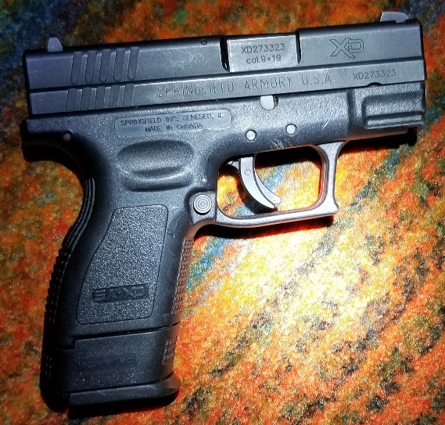
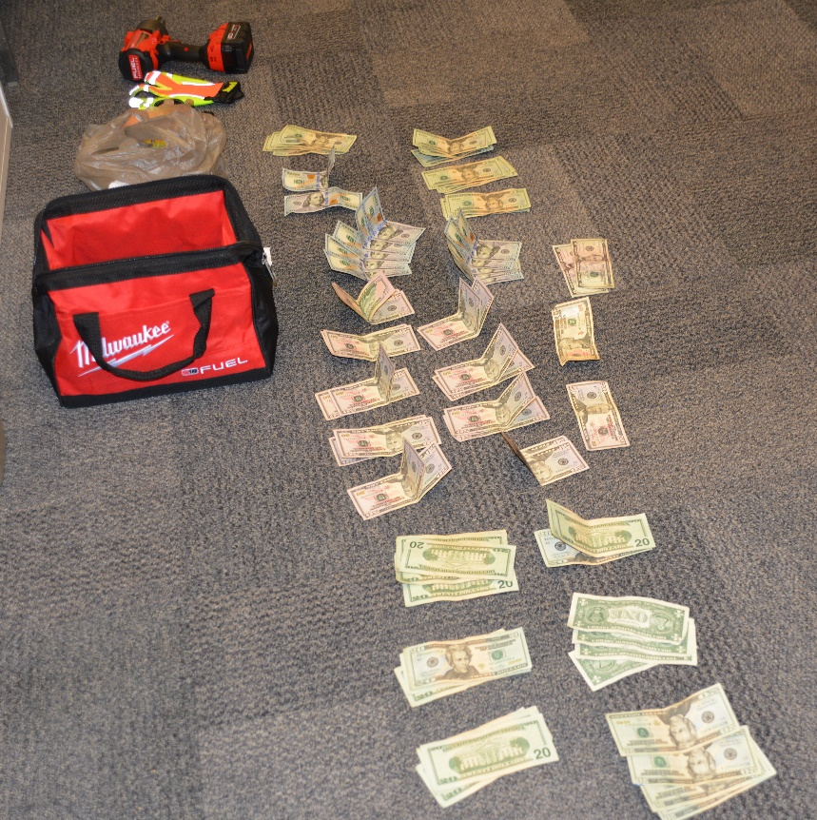
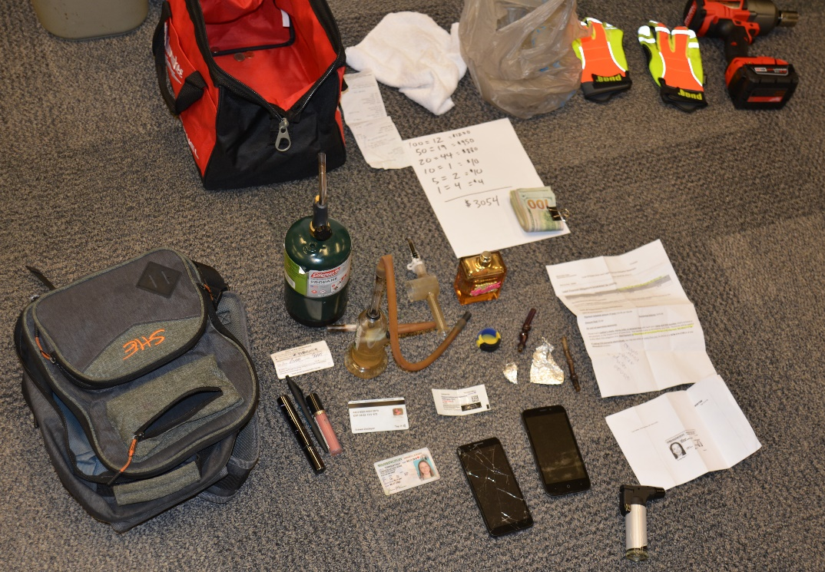
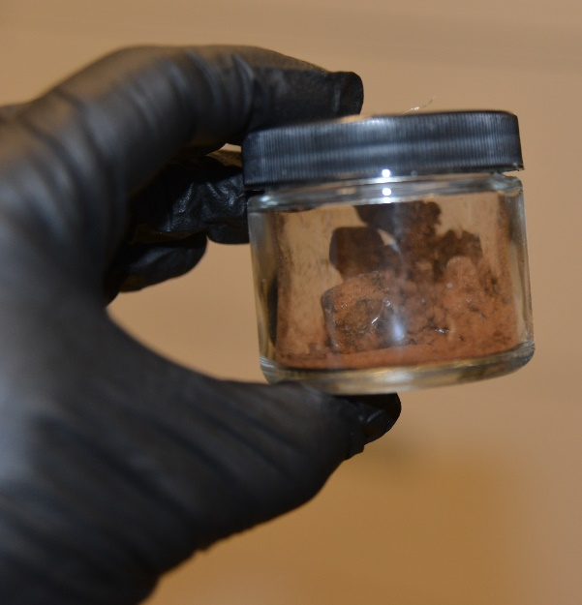
Notes:
HEADER TITLE ALL CAPS AT FONT SIZE 20 CALIBRI (BODY)
Insert text at font size 18 Calibri (Body)
Duplicate this slide as many times as you need it.

Slide 20
Questions?
Notes:
HEADER TITLE ALL CAPS AT FONT SIZE 20 CALIBRI (BODY)
Insert text at font size 18 Calibri (Body)
Duplicate this slide as many times as you need it.

