Slide 1
Kent Mountain View Academy School Zone Establishment
Regular Council Meeting
July 10, 2018
By: Florendo Cabudol, City Engineer

Slide 2
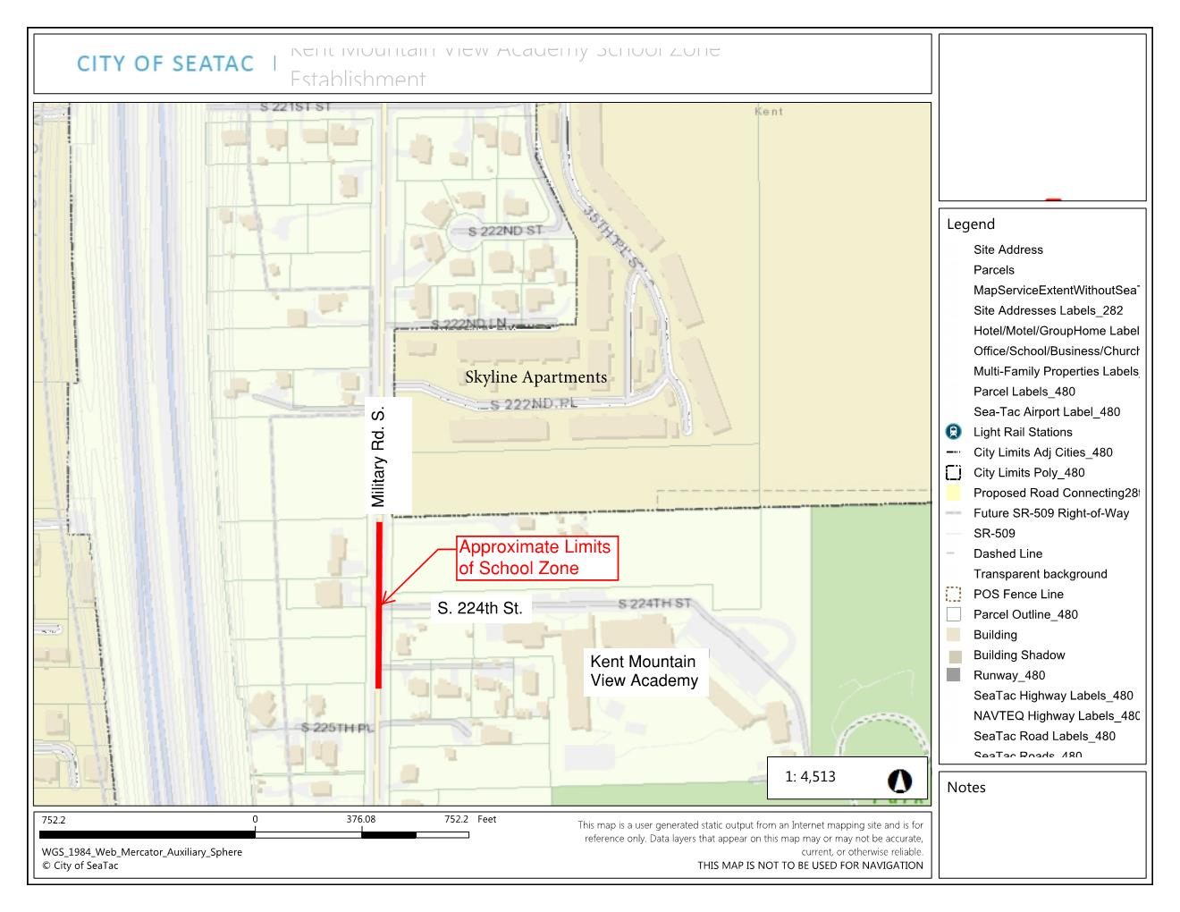

Slide 3
Background Information
Cityworks requests - over the past two years the City has received numerous complaints about excessive speeding along the Military Rd. S. corridor
The speed trailer is frequently placed in various locations along the corridor to slow down traffic
A recent Cityworks request was submitted asking for the establishment of a school zone for the Kent Mountain View Academy in order to improve safety for both the walkers and vehicles traveling to the school

Slide 4
Engineering Study
Traffic count analysis
High traffic volumes (11,800 ADT)
High percentage of traffic traveling above the speed limit (Southbound 83%, Northbound 63%)
Accident history analysis
High accident rate (23 accidents in the last 3 years)
Interview with school officials
School Safety Officer and Principal hold strong opinion in favor of establishment of school zone, they have witnessed many accidents and close calls

Slide 5
Options
Signed School Zone
School zone designated with standard signage on both ends of the school zone (Approximate cost - $1600)
Signalized School Zone (Recommended)
Signs with flashing beacons that are programmable to flash only during school arrival and departure times, solar powered (Approximate cost - $16,000)
This is the recommended treatment due to the speeds and traffic conditions on Military Rd S
Notes:
***Shared with TPW Committee on 5/17/18 (from minutes)***
Following a number of resident complaints about speeding at the Kent Mountain View Academy, located off of Military Rd S and S 224th Street, the City looked into establishment of a School Zone. A traffic study determined that 83% of southbound Military Rd S traffic sped above the 35 MPH rate, and 63% of the northbound traffic sped. Also there have been 23 accidents in 3 years at or near this location. Kent School District confirmed that several children are walking from the neighborhood, and several children have been observed crossing dangerous Military Road to reach the school.
Establishing a School Zone, includes signage with flashing beacon for 20 MPH in the zone. Signage without the flashing beacon will cost the City $1600, and with the beacons $16,000. The City is recommending the flashing beacons.
A comment was made to be prepared to look at all of the schools in the City, and revisit the criteria for flashing beacons at each location. No other school zone in the City has the flashing beacons. A flashing LED stop sign was placed recently at 42nd & S. 182nd outside Bow Lake Elementary.

Slide 6
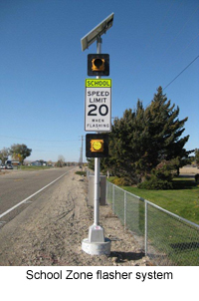
Example of a Flashing Beacon for a Signalized School Zone

Slide 7
Next Steps
Confirm extents of school zone and placement of Flashing Beacons
Coordinate installation with the Kent School District
Install the school zone before the beginning of the next school year – August 30th

Slide 8
Questions?

