Slide 1
34th Avenue South Sidewalk Project
Regular Council Meeting
July 10, 2018
By: Florendo Cabudol, City Engineer

Slide 2
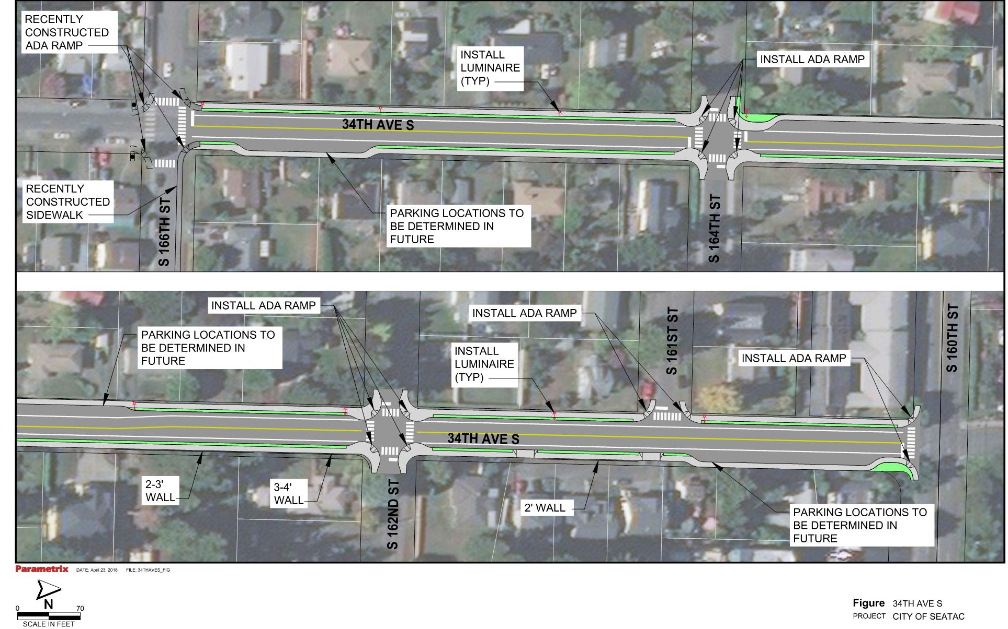
Notes:
Use this slide or next

Slide 3
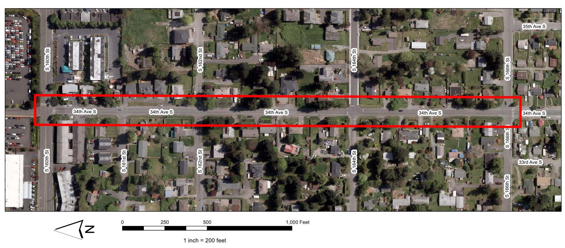
Notes:
Use this slide or next

Slide 5
Questions?

