Slide 1
Permit Parking Program
Public Safety and Justice Committee
January 4, 2018
Presented by: William Appleton, Public Works Director
Gus Brandon Garcia, CEII

Slide 2
Permit Parking Program
Public Safety and Justice Committee Presentation

Slide 3
Project Needs and Objectives
Council and Committee directed staff to engage in the development of a Permit Parking Program (P3) to:
Create a program and process to reduce parking impacts from non-resident motorist and TNC operators.
Prioritize on-street parking to area residents and guests
Manage demand during high occupancy periods
Develop a program that is adaptive and can be replicated in other neighborhoods in the City.

Slide 4
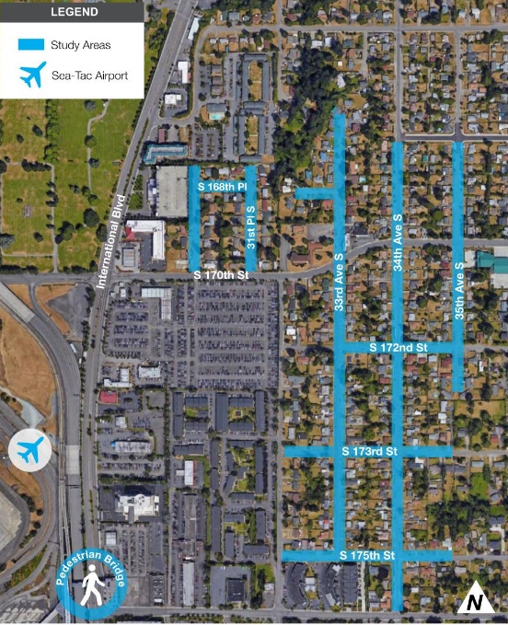
Study Area Proposed For P3 Implementation
Study Area 1
McMicken Heights
Sue Linda Sub-Division

Slide 5
Implementation/Next Steps
Identify the preferred frame work for the P3 then:
Draft City Ordinance establishing and defining the P3 program. The Ordinance will contain the process and criteria necessary to qualify for a P3 zone
Develop implementation plan based on the resource needs of the program.
Draft roll-out (Beta Test)
Final program with initial staffing and equipment identified and purchased

Slide 6
Projected Implementation Schedule

Slide 7
Software Hardware Options
Genetec – AutoVu – These are biggest name LPR Camera Systems
IPS Group – fully suite of parking hardware, software, and enforcement
NuPark – parking software works with LPR
AutoChalk – Camera and Software
Gtechna – provides Android/Windows apps for handhelds and phones to do LPR
OmniPark – parking software solution
T2 Systems – software and hardware
Nedap identification systems – lpr
Cale America – full suite of parking hardware and software

Slide 8
Questions?

