Slide 1
Right of Way Vacation – Orillia Rd. South
Agenda Bill 4633
Regular City Council - June 27, 2017
By: William Appleton, Public Works Director

Slide 2
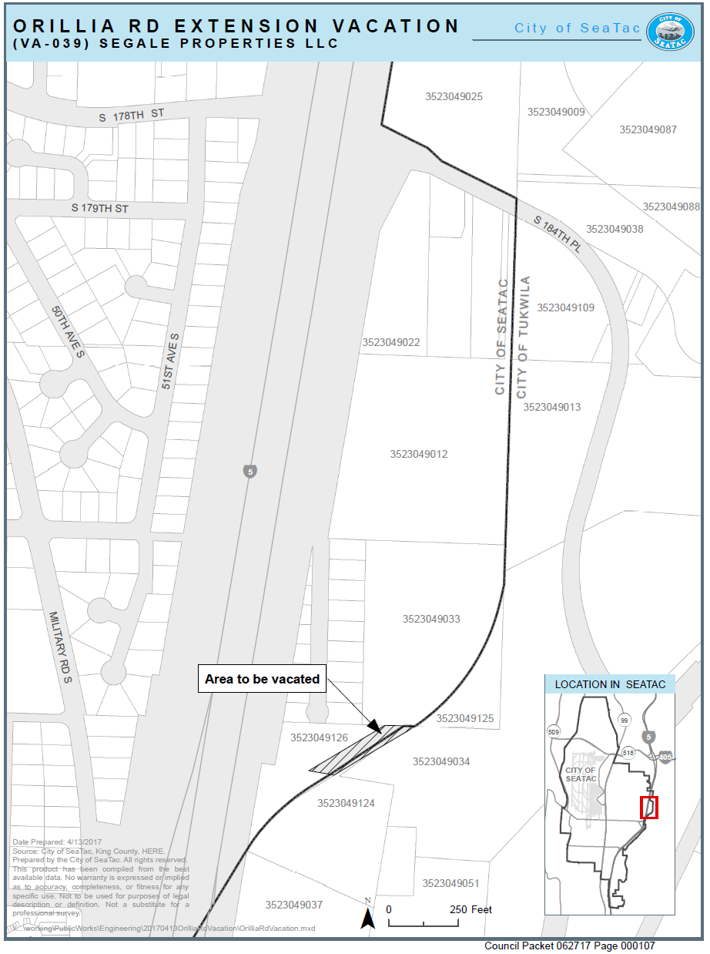

Slide 3
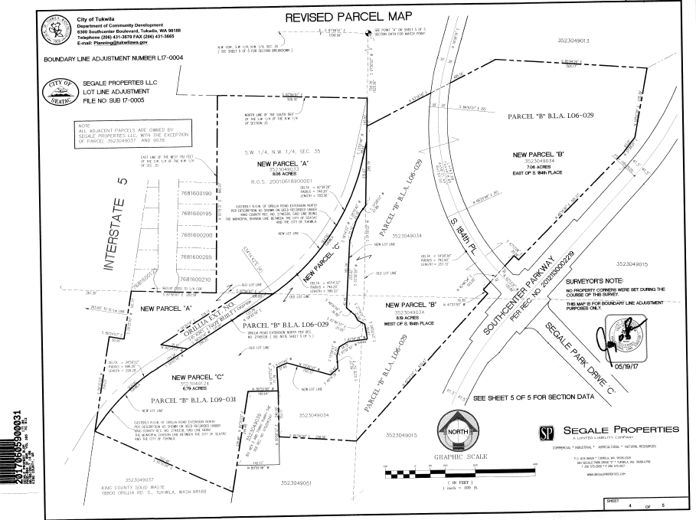
Exhibit A
Area to be Vacated

Slide 4
Questions?

