Slide 1
Neighborhood Sidewalk Program
Neighborhood Sidewalk Committee
March 16, 2017

Slide 2
Neighborhood Sidewalk Program Purpose:
Safely and comfortably accommodate walking, bicycling, wheelchairs and other mobility enhancement devices, automobiles, service vehicles and in some cases transit, while also improving neighborhood livability, aesthetics, and property values.

Slide 3
Program Goals
Consider all users and transportation modes
Support walking and bicycling as viable modes of transport
Improve neighborhood aethetics, livability, and property values
Provide for people with disabilities
Provide green infrastructure in our neighborhoods
Provide projects that support increased property values
Other goals………..

Slide 4
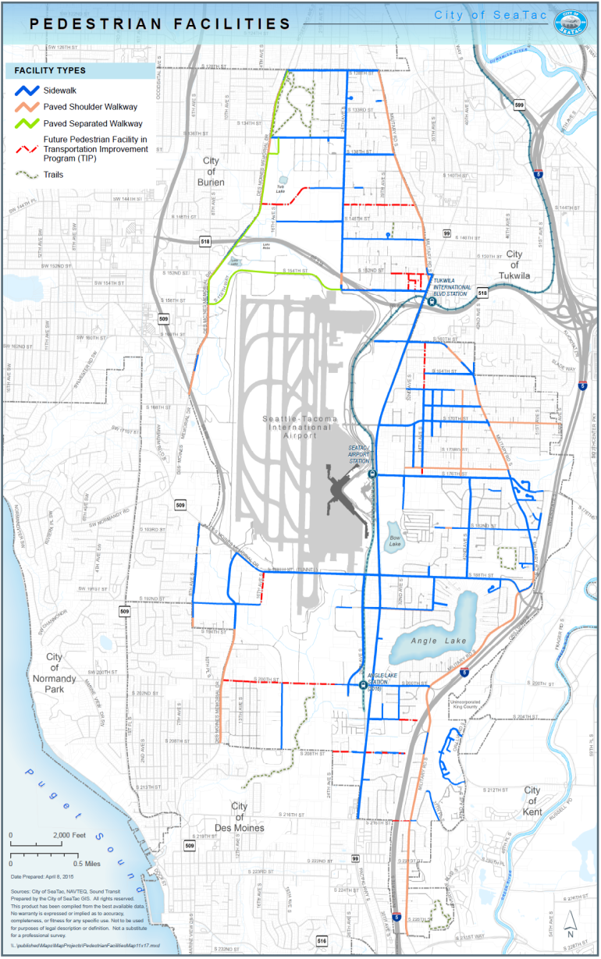
SeaTac Neighborhoods Existing Conditions
75 centerline miles of streets with sidewalks
42 miles of sidewalk built since incorporation
Lots left to do

Slide 5
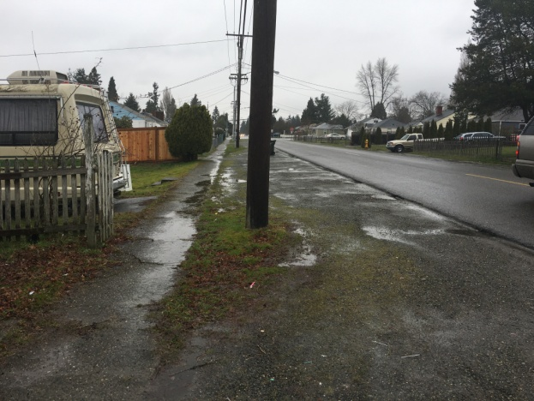
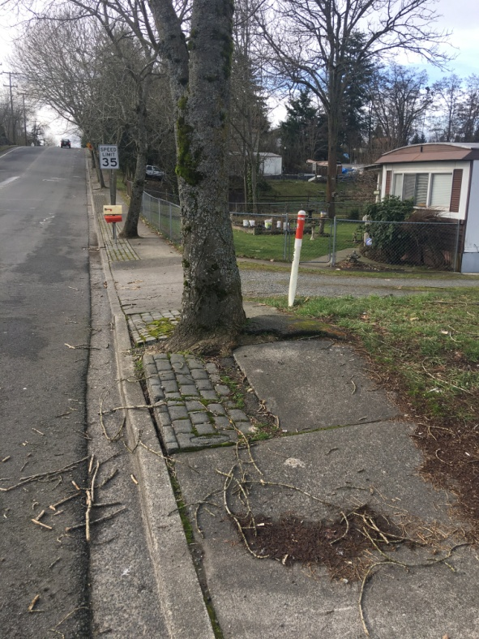
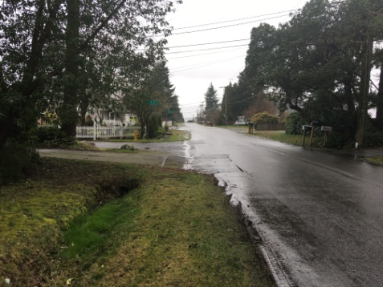
SeaTac Neighborhoods – Existing Conditions

Slide 6
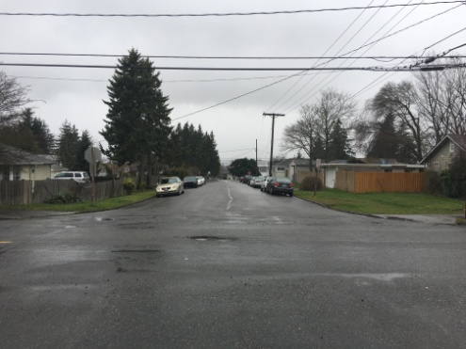
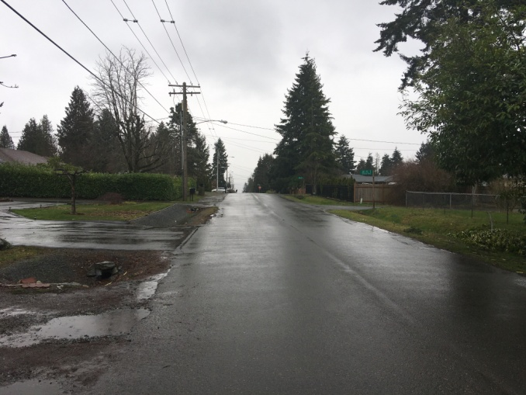
SeaTac Neighborhoods – Existing Conditions

Slide 7
Projects Completed Since 2009
42nd Avenue South, South 188th Street to South 176th Street
South 138th Street, Military Road South to 24th Avenue South
South 164th Street, 34th Avenue South to Military Road South
South 168th Street, Military Road South to 34th Avenue South
South 179th Street, Military Road South to 42nd Avenue South
37th/40th Avenue South, South 172nd Street to South 166th Street
32nd Avenue South, South 192nd Street to South 188th Street

Slide 8
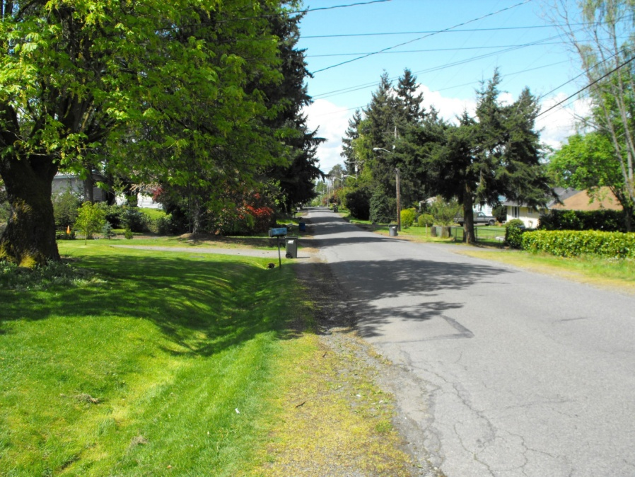
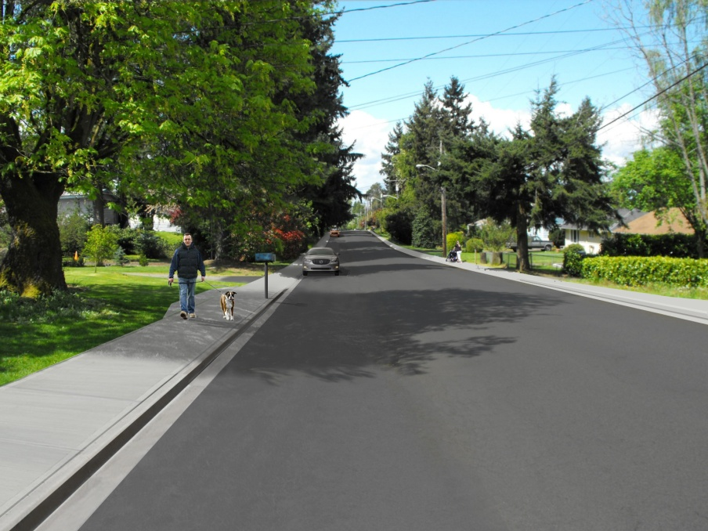
Completed Sidewalk Project
S 164th Street, between 34th Ave s. & Military Rd

Slide 9
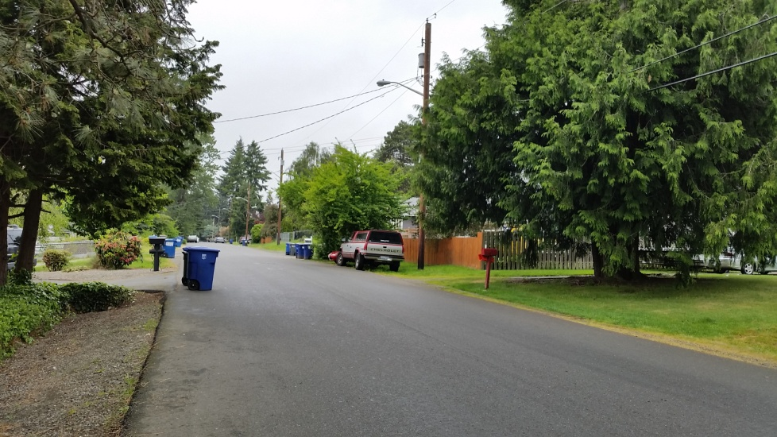
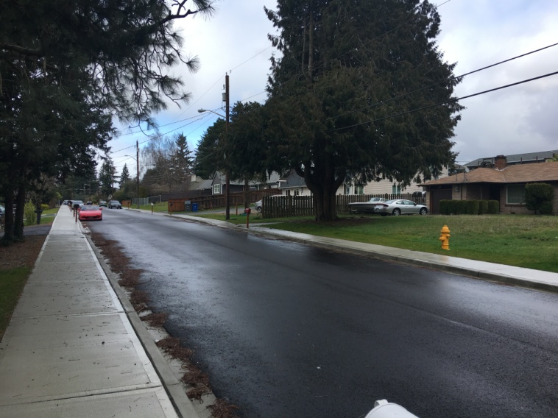
Completed Sidewalk Projects
32nd Avenue South, South 192nd Street to South 188th Street

Slide 10
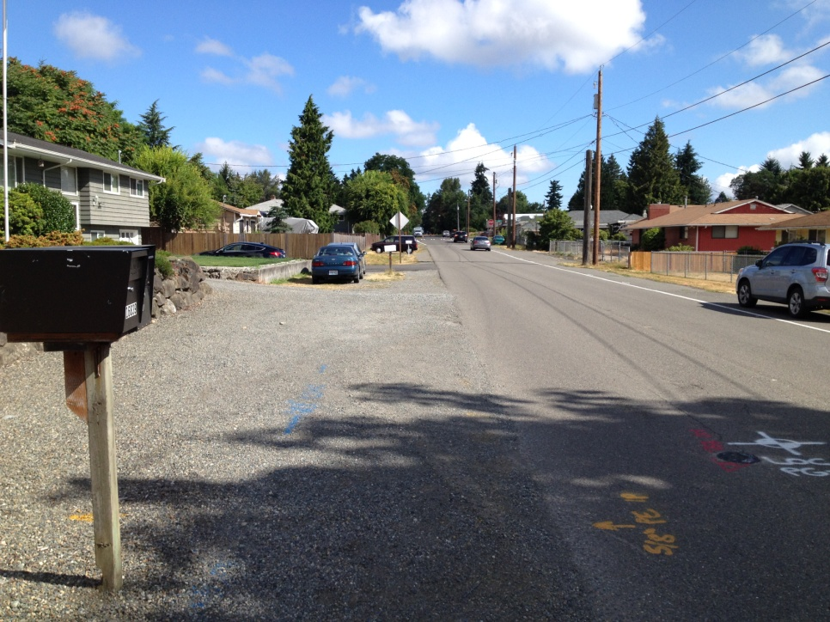
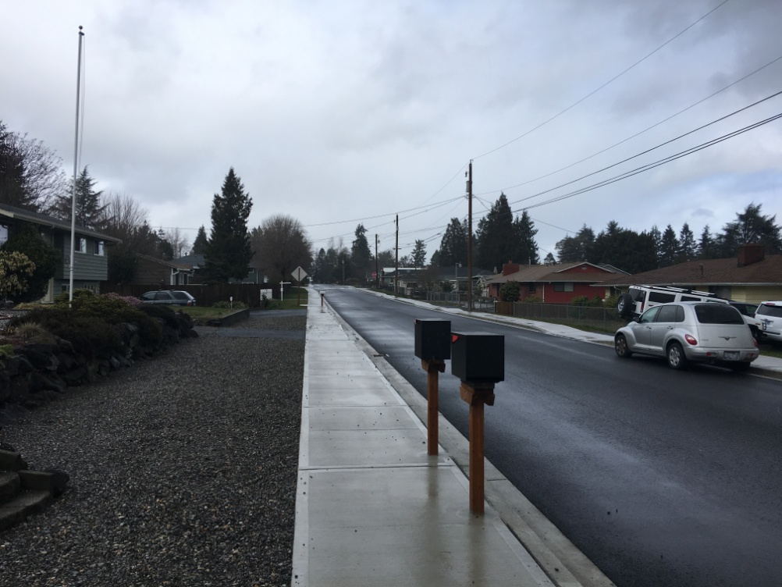
Completed Sidewalk Projects
37th/40th Avenue South, South 172nd Street to South 166th Street

Slide 11
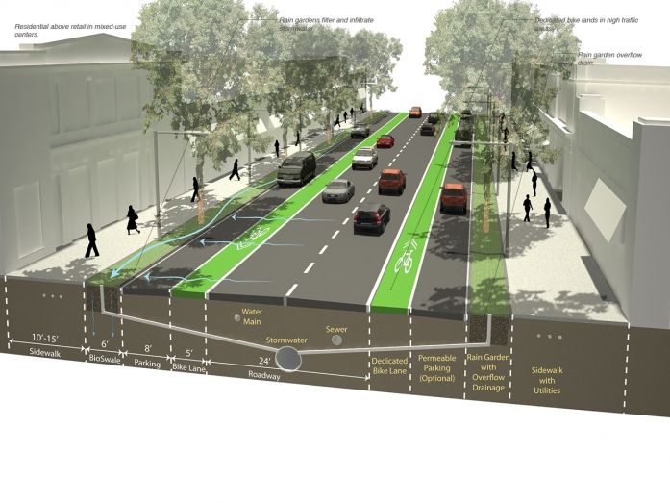
Anatomy of a Street
Sidewalk
Street Trees
Bike Lane
Stormwater Treatment
Sidewalk
Parking
Sidewalk
Pedestrian/ Street Lighting
Underground Utilities
Public Art
Above ground Utilities
Mailboxes
Driveway Access
Traffic Calming

Slide 12
SeaTac Neighborhood Section
Included
Not Included
Parking
Greenscape
Mailboxes
Lighting
Driveways
Street Trees
Traffic Calming
Stormwater Conveyance
Bike lanes
Way finding signs
Sidewalk
Stormwater Treatment
Utility undergrounding

Slide 13
Sidewalk Discussion Topics
Sidewalk Width
Pedestrian Lighting
Utility Undergrounding
Landscaping
Traffic Calming
Goal: Obtain feedback from the committee on these elements to help inform the design of “typical” sections.

