Slide 1
The Port of Seattle:
Economic Development in Action
January 24, 2017

Slide 2

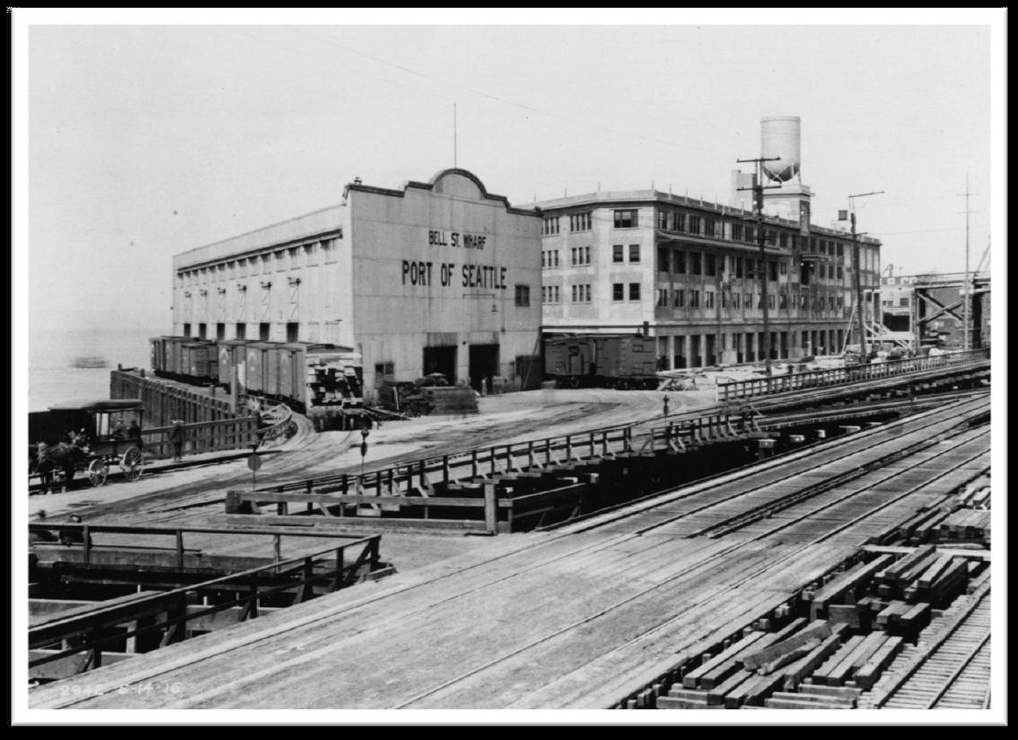
Overview
Introduction
Economic Development Division
  Real Estate Development
  Small Business Development
  Workforce Development
  Tourism
  City Partnership Grants
Soundside Alliance
Final Thoughts
The Port of Seattle has generated jobs and economic activity for over 100 years.

Slide 3

2016: A Big Year for the Port
Air Passengers | Air Cargo | Cruise Passengers | Sea Cargo with the NW Seaport Alliance
+10% Passenger growth | +7% in 2016 (by MT) +15% in domestic freight service | Record breaking 984,000 PAX 9.5% Increase Double industry average | Loaded Containers +3% Imports YTD +15% Exports YTD
The Port is Riding the Wage of Our Strong Regional Economy

Slide 4
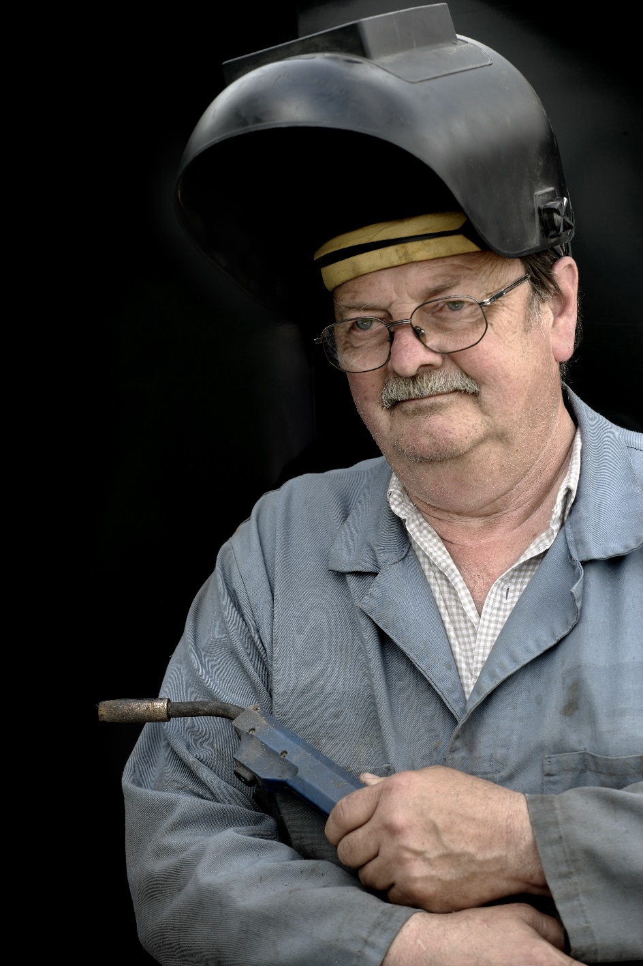
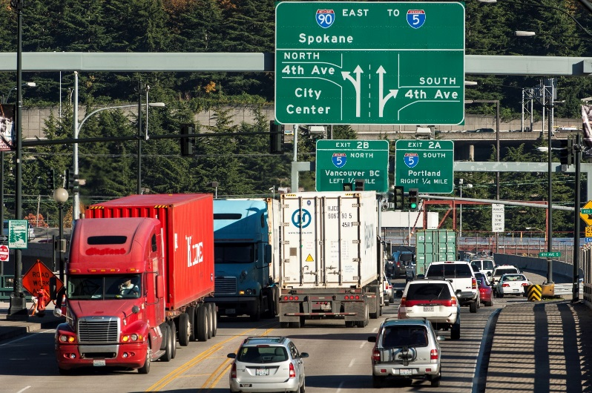
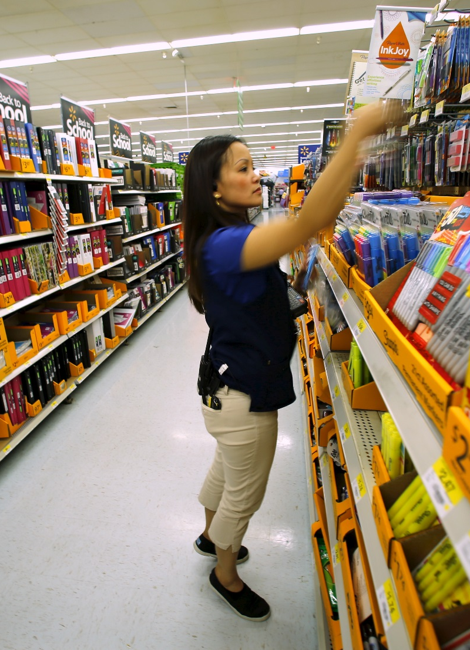
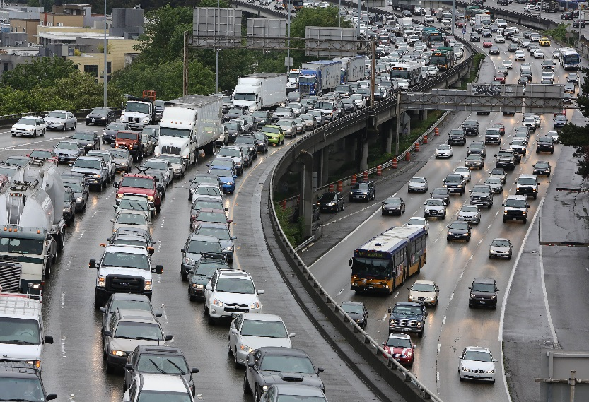
Challenges Remain
Aging Workforce
Overcapacity Infrastructure
Shrinking Middle Class
Community and Economic Development as Important as Ever

Slide 5
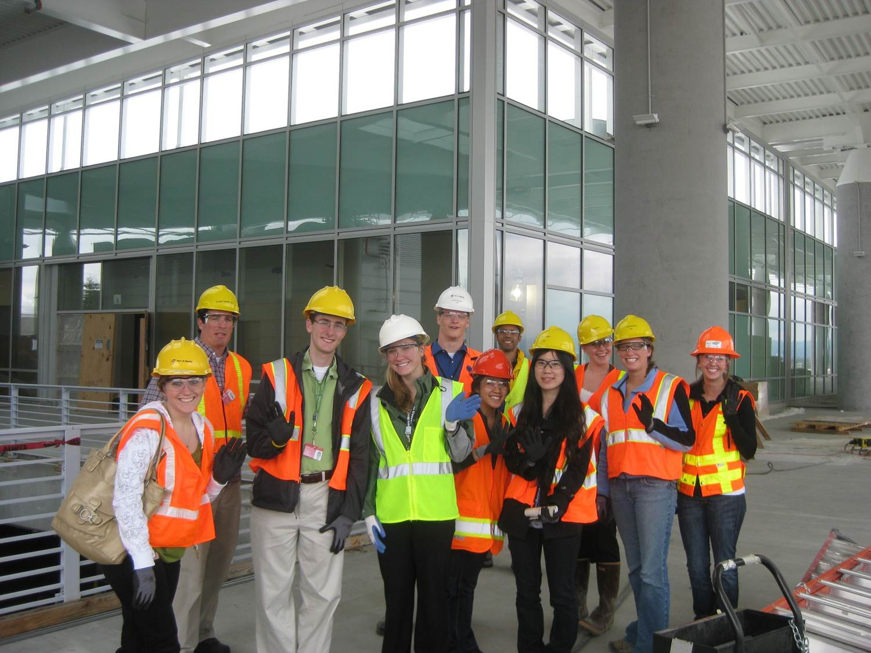
Economic Development Division
A new Division that brings together traditional and new Port initiatives:
Real Estate Development and Management
Small Business Development (including incubators and accelerators)
Workforce Development
Tourism
Business Prospecting and Recruitment
Other Duties As Designed or Assigned!
200,000+ Jobs – Shared Prosperity – King County & WA State

Slide 6
Des Moines Development Opportunities
SeaTac Development Opportunities
Burien Development Opportunities
Putting a Shovel to Port Properties Around the Airport

Slide 7

Evaluating Our Real Estate Development Options
Port Finishes Real Estate Strategic Plan
  Reevaluated Port properties for highest potential
  Looked at non-Port owned properties for longer term acquisition (or control)
  Study finished in October
    the Port is evaluating over $500 million in development options
    We are moving forward on several projects

Slide 8
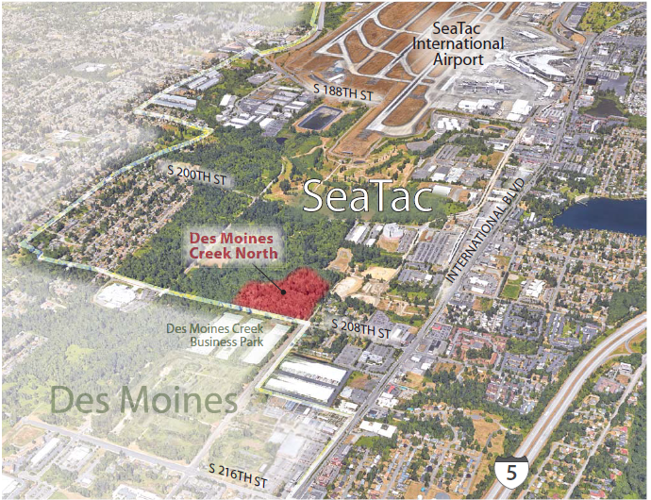
Des Moines Creek - North RFP
Moving forward to develop approximately 22 acres
Proposals due February 10th
Will likely pick preferred developer by end of March
Due Diligence period to follow
Seek Commission approval for ground lease this summer
New Development and Jobs for SeaTac

Slide 9
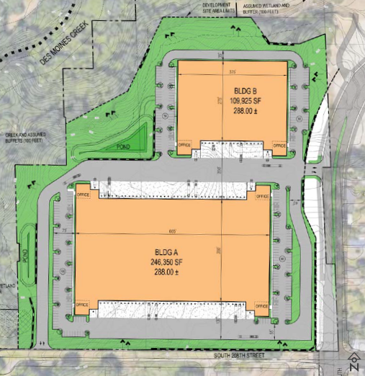
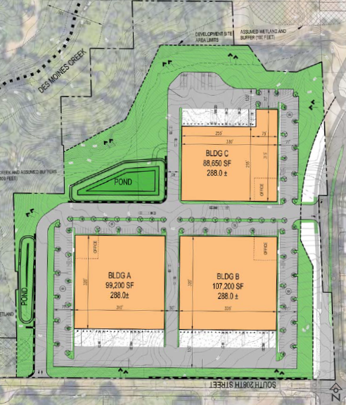
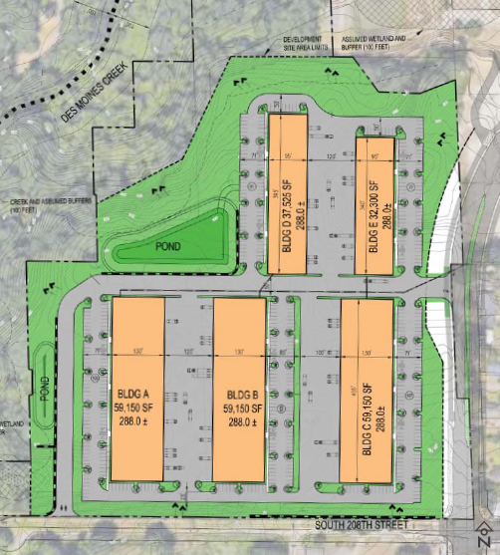
Des Moines Creek - North Possibilities
Distribution – Manufacturing – Business Park

Slide 10
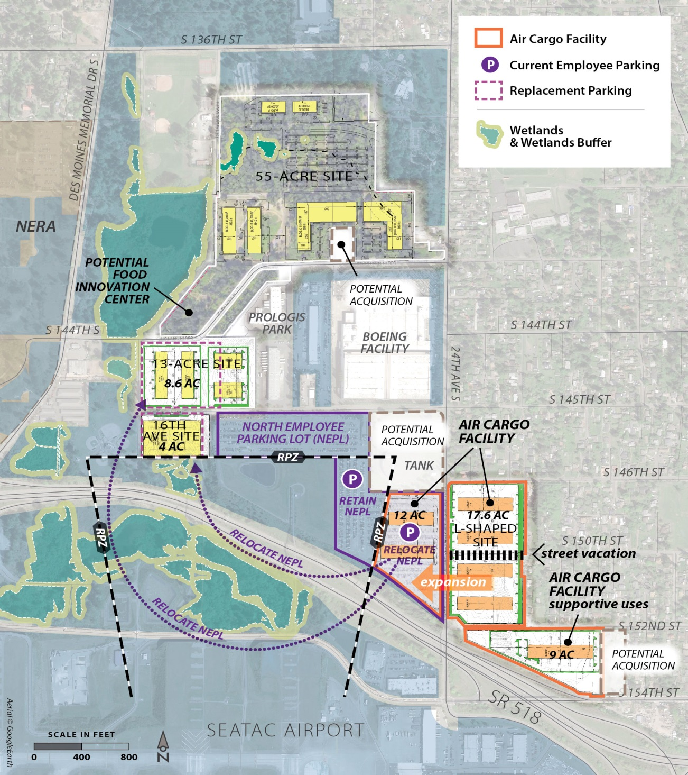
North SeaTac Real Estate Strategy
Development Alternatives
289,200 SF in new air cargo facilities with some expansion potential (to 375,000 SF).
Re-locate employee parking lots
Up to 390,000 SF on 55-Acre and 13-acre sites depending on final parking configuration.
Site Specific Strategies
Support air cargo displacement
Relocate employee parking to make room for air cargo
Facilitate additional development
Explore development of food processing incubator

Slide 11
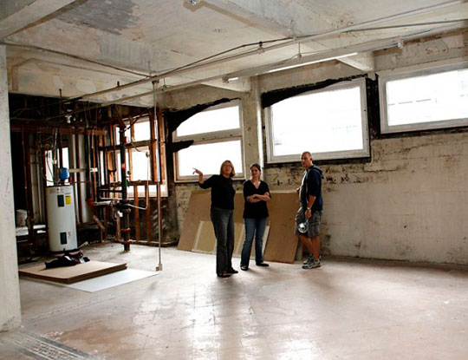
Small Business Development
Port Century Agenda:
Increase the proportion of funds spent by the port with qualified small business firms on construction, consulting, goods and services to 40 percent of the eligible dollars spent
The Port spent about 30% of its capital budget with small businesses in 2016

Slide 12

New Initiative: Incubator/Accelerator
Commission interested in supporting and advancing small business in key Port industries
Completed Assessment of incubators in King County:
  There are approximately 60 accelerator, incubators and coworking spaces in King County;
  Successful incubators provide more than space.
  Incubator success depends on both design/development at the outset and successful operations management on an ongoing basis
  The Port can play a positive role

Slide 13
Recommendations
Provide Space, Land and Operating Support for Incubators…
Maritime Incubator
  Utilize Port-owned land at Fisherman’s Terminal or uplands at Terminal 91 to support an incubator focused on the marine industry.
Construction Incubator
  Utilize some of the Port’s available building space to develop a one-stop support center for small businesses in construction, architecture, engineering or similar fields.
Commercial Food Processing Incubator
  Provide a shared-use, licensed, commercial kitchen that allows entrepreneurs to develop products and enterprises without the high overhead cost of purchasing facilities, equipment, and necessary licensing.

Slide 14
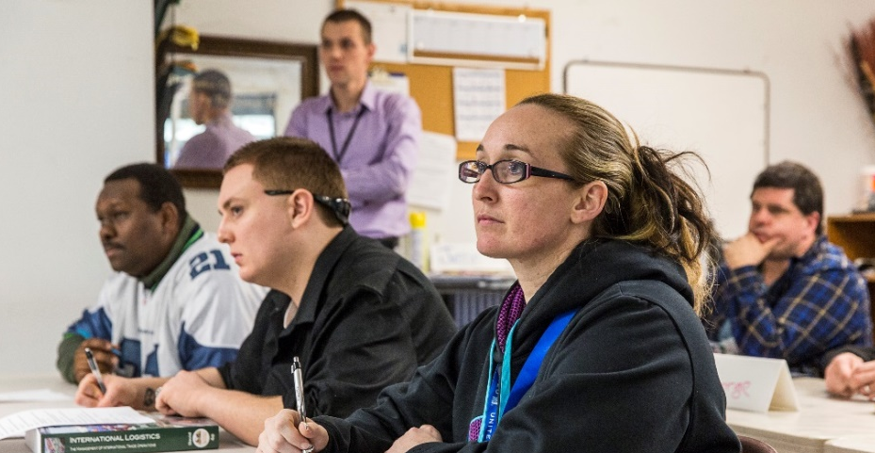
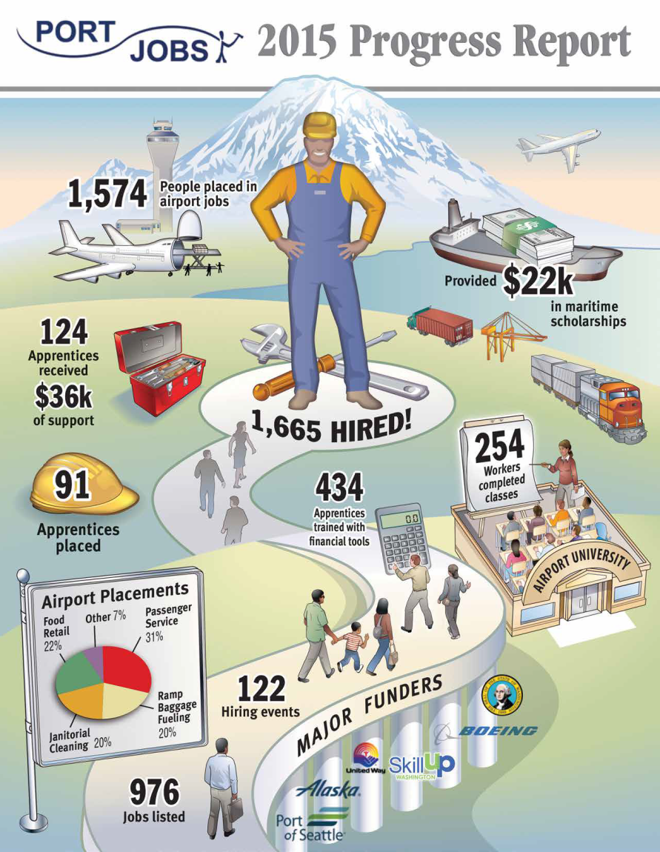
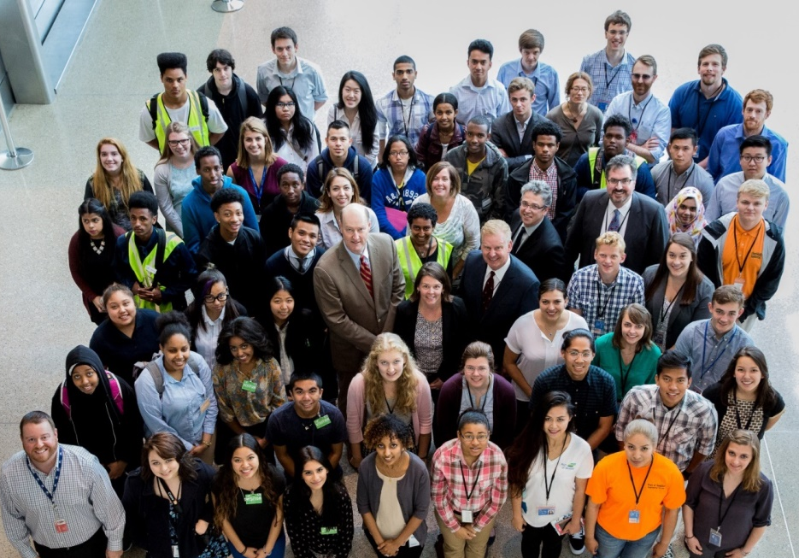
Workforce Development
PortJobs 2015 Progress Report
Airport University
Port High School Intern Class 2016
Placement and Training at SeaTac

Slide 15
Port-Related Workforce Priorities
Maritime Occupations
Sailors, Marine Oilers, Ship Engineers, Marine Electricians, Welders, HVAC
Airport–Related Occupations
Passenger air, Air cargo, Logistics, Maintenance, Restaurant, Hospitality, Retail
Construction Occupations
Trades & Maintenance Laborers, Electricians, Pipefitters, Carpenters
Manufacturing Occupations
Machinists, Assembler, Inspectors, Testers, Welders, Mechanics
Developing a Talent Pipeline

Slide 16
Career Connected Learning Continuum
Anatomy of a Talent Pipeline
Awareness
Exploration
Preparation
Skills Training and Educaton
Career Fairs
Industry Speakers
Worksite Tours
networking events,
job shadows,
work based problems classroom
career prep instruction
Worksite Learning
Internships
On-the-Job Training
Apprenticeship
Vocational/Educational
Clinical Experience
Supports education and career readiness
Middle School
9th - 10th Grade
11th- 12th grade
Post High School
Helping Kids Discover and Realize their Potential

Slide 17
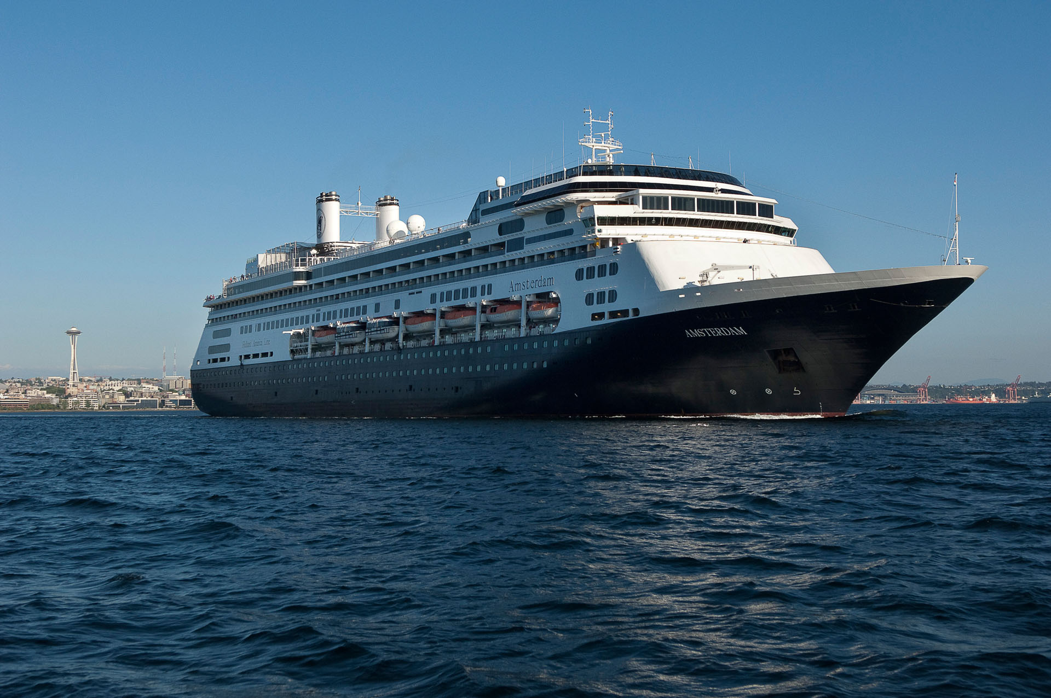
Tourism
MISSION
Enhance our region’s attractiveness as a tourism destination by promoting tourist options in the state for visitors who use
SeaTac, Port cruise terminals or marinas.
GOALS
Increase international visitor traffic
Encourage longer stays via Cruise & Stay/Fly & Drive Products
Institute a small community Tourism Grant Program
International Visitors Stay on Average 18 Nights in USA

Slide 18
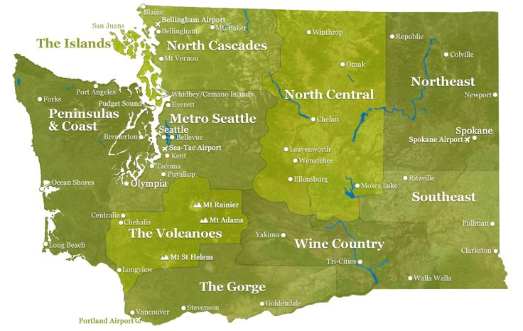

Port Leadership in Tourism
Tourism Grant Award Locations
$150,000 Available for 2017 Grant Program – Applications Accepted Until Feb. 22

Slide 19
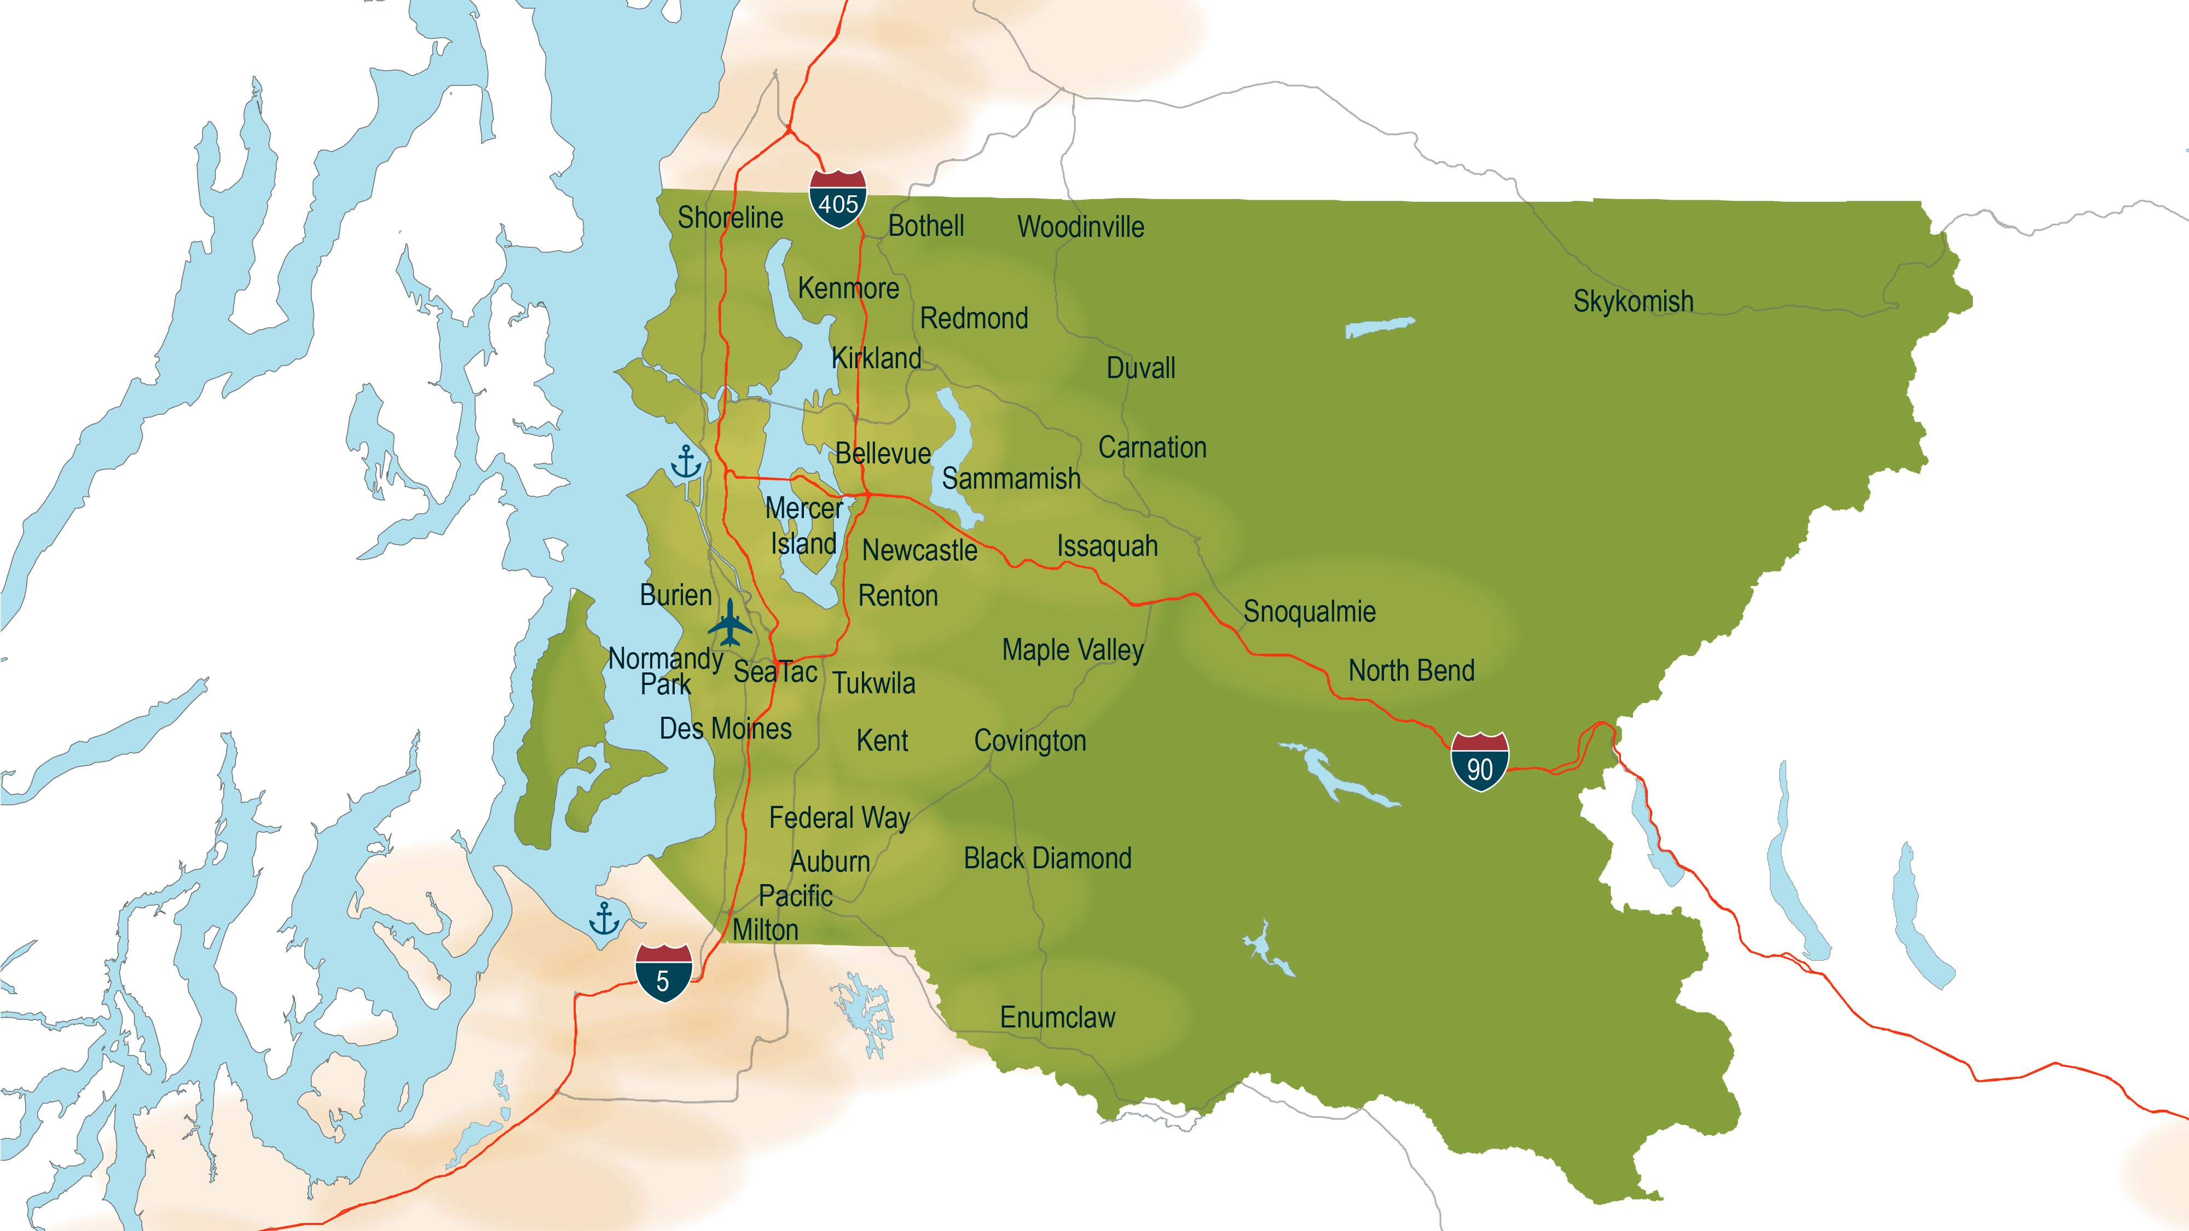
2016 Economic Development Grants
Nearly $1 Million in Economic Grants for 31 King County Cities
Partnerships to Create Jobs & Economic Vitality

Slide 20
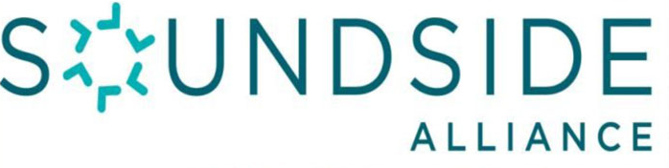
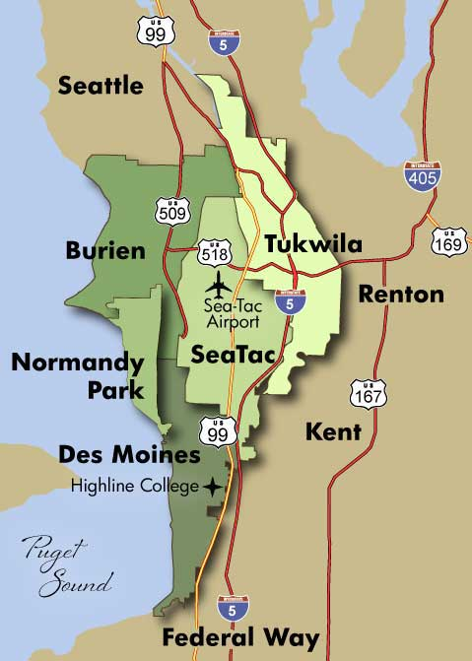
Regional Efforts are Important
Game plan established – May benefit from revisiting
Port supports staffing the Alliance
The Innovation Triangle Example
  Bellevue, Kirkland & Redmond working together
Engage Elected Officials and Staff to Keep Vision and Partnership Alive

Slide 21
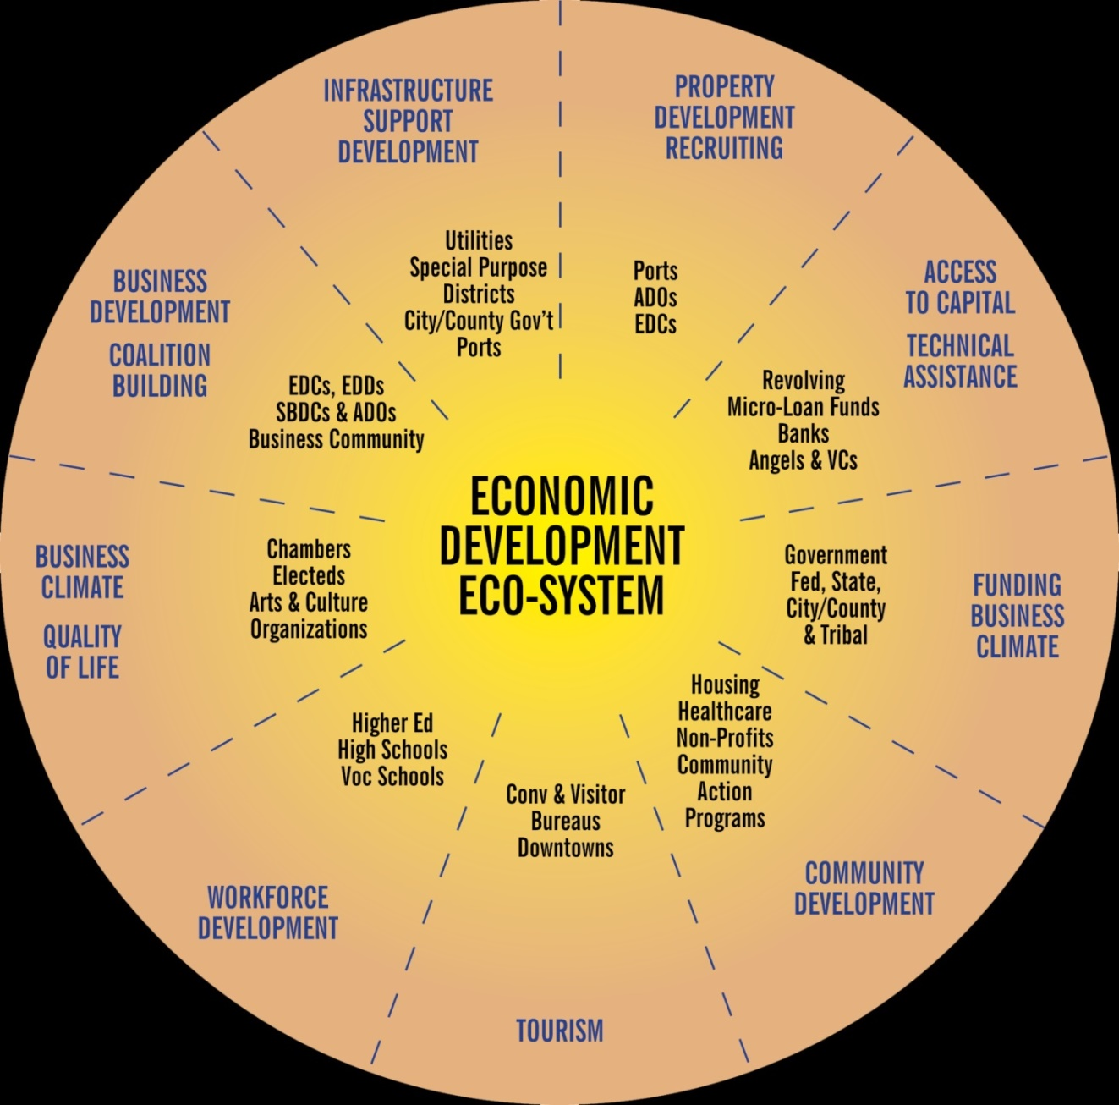
Economic Development is a Team Sport!

Slide 22






On the Horizon
Feb. 1 – Port of Seattle Construction Industry Day, showcasing North Satellite (1 – 3pm)
Feb. 1 – Open House for Sea-Tac Airport Flight Corridor Safety Program (6 – 8pm)
Feb. 3 – Groundbreaking for North Satellite Renovation & Expansion
Feb. 10 – Tourism Marketing Support Program Information Session
April 8 – Airport Sustainability Tour (Save the Date!)
Stay Informed…
www.portseattle.org
facebook.com/portseattle
linkedin.com/company/port-of-seattle
instagram.com/portofseattle
twitter.com/portofseattle
youtube.com/user/PortofSeattle

