Slide 1
City of SeaTac
Transportation Impact Fee Update

Slide 2
Traffic Impact Fee Update
Align TIF with updated 20-year plan
Adopt Deferral System for impact fees
Update timeframe for expenditure of fees
Notes:
TIF is just one piece of the development review puzzle. There are four primary tools that agencies use in reviewing transportation system impacts for new development applications:
TIF
Optional GMA element
Addresses impacts to the “system”
Funding transportation system improvements
Concurrency
Required by GMA
Timing/adequacy of facilities concurrent with development impacts
Requires denial if development causes the level of service to decline below adopted standards
Can be implemented as part of SEPA or reviewed separately
Frontage Improvements
Project related infrastructure and on-site improvements.
SEPA
Reviewed on a development by development basis
Broad scope can be used to address capacity, safety, operations, non-motorized impacts, and transit
Uses “significant adverse impact” standard (not just level of service)
Does not require denial of developments if standards are not met

Slide 3
What Are Transportation Impact Fees
Impact fees are one-time charges assessed by local governments against a new development project to help pay for new or expanded public facilities that will directly address the increased demand created by that development.

Slide 4
Use of Transportation Impact Fees
Capital facilities that are reasonably related to the new development, directly benefit the new development & serve the community at large.
Intersections
New roadway segments
Upgrade/reconstruction of roadway segments
Building/widening roadway shoulders
Non-motorized enhancements (bike lanes, sidewalks)

Slide 5
TIF Calculation (20-year TMP)
Program Costs
_______________
TIF Eligible Cost
÷
Growth Trips
=
Cost per Trip
$259,000,000
_______________
$58,952,000
÷
15,728
=
$3,748
Notes:
Recovery Cost (~83% of TIF Eligible Costs)
~15,700 PM peak hour trips

Slide 6
TIF Cost Per Trip
Current Adopted
$1,020 per trip
Range supported by 2015 TMP
~$2,800 to ~$7,500 per trip
Recommendation – 20-year plan
~$3,500 per trip
Annual escalator (WSDOT Construction Cost Index)

Slide 7
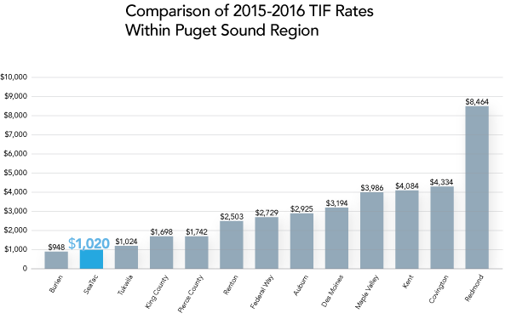
Agency Comparison
Notes:
Brent to add TAZ graphics

Slide 8
Development Scenarios ($3,500 TIF)
Single-family (per dwelling unit) - $3,500
Apartment (per dwelling unit) - $2,170
General Office (per 1,000 square feet) - $5,215
General Light Industrial (per 1,000 square feet) - $3,395
Variety Store (per 1,000 square feet) - $15,754
Free Standing Discount Superstore (per 1,000 square feet) - $14,466
Fast Food Restaurant with Drive-Through (per 1,000 square feet) - $57,138
Residence Inn – $77,000 vs. $262,000

Slide 9
TIF Deferral
Adopt and maintain a system for the deferred collection of impact fees for single-family detached and attached residential construction. (by Sept 1, 2016)
Must include one or more of the following options:
(A) Deferring collection of the impact fee payment until final inspection;
(B) Deferring collection of the impact fee payment until certificate of occupancy or equivalent certification; or
(C) Deferring collection of the impact fee payment until the time of closing of the first sale of the property occurring after the issuance of the applicable building permit.

Slide 10
TIF Expenditure Timeframe
SeaTac code currently requires expenditure of TIF revenue within 6-years of being collected
RCW now allows for up to 10-years to expend TIF revenues.

Slide 11
Recommendations
Amend SMC to:
Set TIF at $3,500 per p.m. peak hour trip effective January 1, 2017
Adopt the proposed deferral system for impact fees to be paid at time of final inspection for single family construction.
Allow for TIF revenue to be expended within a 10-year timeframe rather than six.

Slide 12
Q&A
THANK YOU

Slide 13
Backup Slides

Slide 14
TIF Update Process
Identify
Impact Fee
Eligible
Projects
Calculate
Impact Fees
And Rate
Schedule
Program
Implementation

Slide 15
GMA Requirements
Optional element under GMA – related to funding
Used to help mitigate development impacts
System improvements – not project improvements
Not used to resolve existing deficiencies
Pooling of funds allowed

Slide 16
Non-Eligible TIF Project Types
Project-level improvements
Other agency-owned facilities
Maintenance
Non-capacity improvements
Safety projects
Funded by grants/other sources

Slide 17
TIF Cost Share
Existing Deficiencies
Capacity shortage
Maintenance
Other Agency Share
WSDOT
Cities
Other Funding Sources
Grants
Earmarks
Notes:
TIF/Teapot

Slide 18
Redmond $8,462
SeaTac $1,020 (last updated in 2002)
Kitsap County $515
Average $2,846 Median $2,193

Slide 19
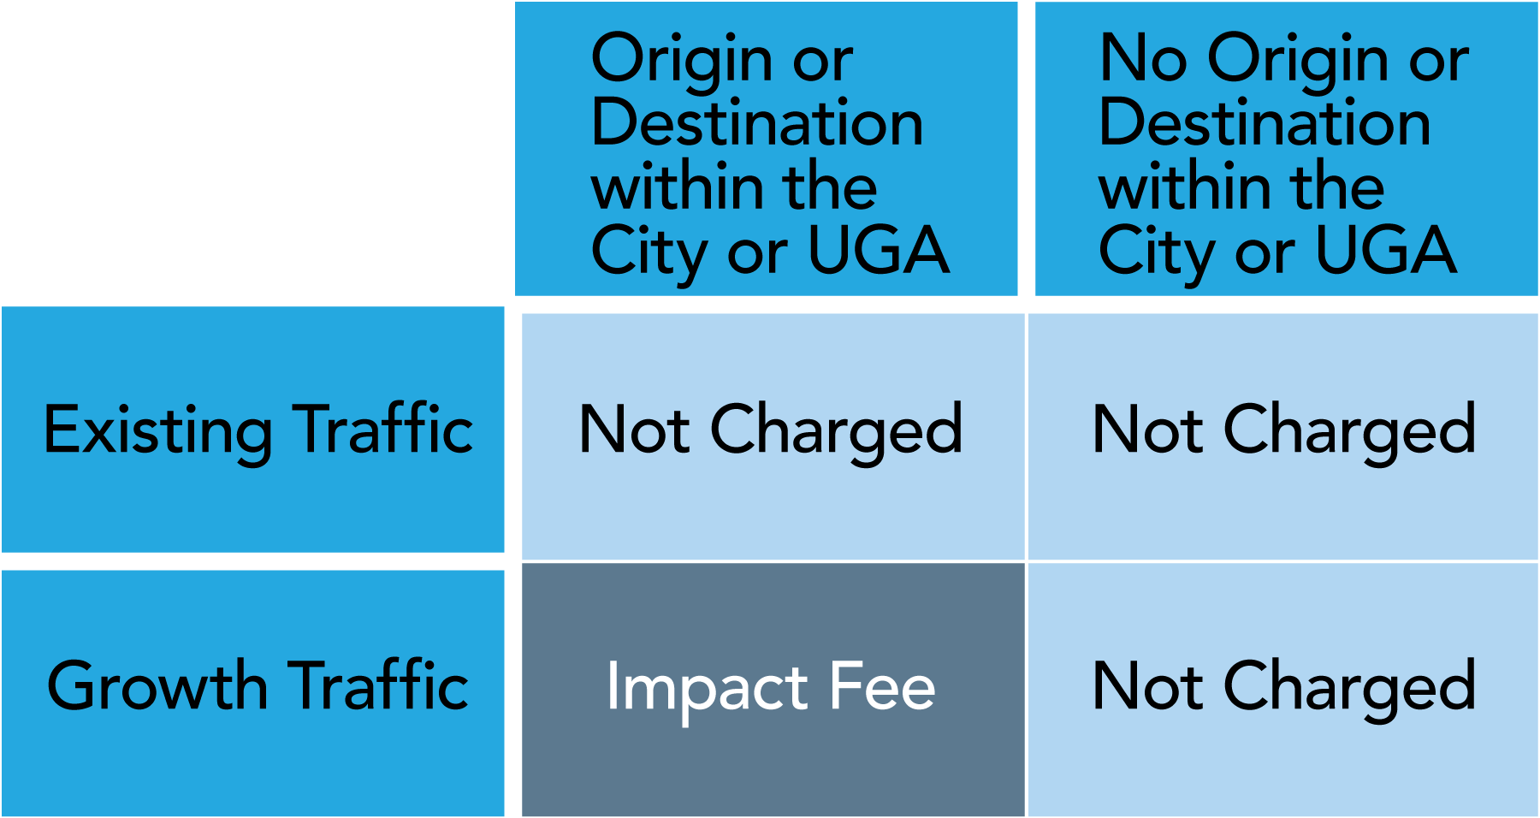
Allocating Cost to Growth

Slide 20
TIF Perceptions
Can be seen as driving up the cost of development, both housing and commercial
Differences in impact fees between jurisdictions may affect location of development
May be difficult for public to understand

Slide 21
LOS Standards
Weekday PM peak hour
Applied to intersections and roadways
LOS E or better for Principal or Minor arterials
LOS D or better on Collector arterials and lower classification streets

Slide 22
VMT Growth

Slide 23
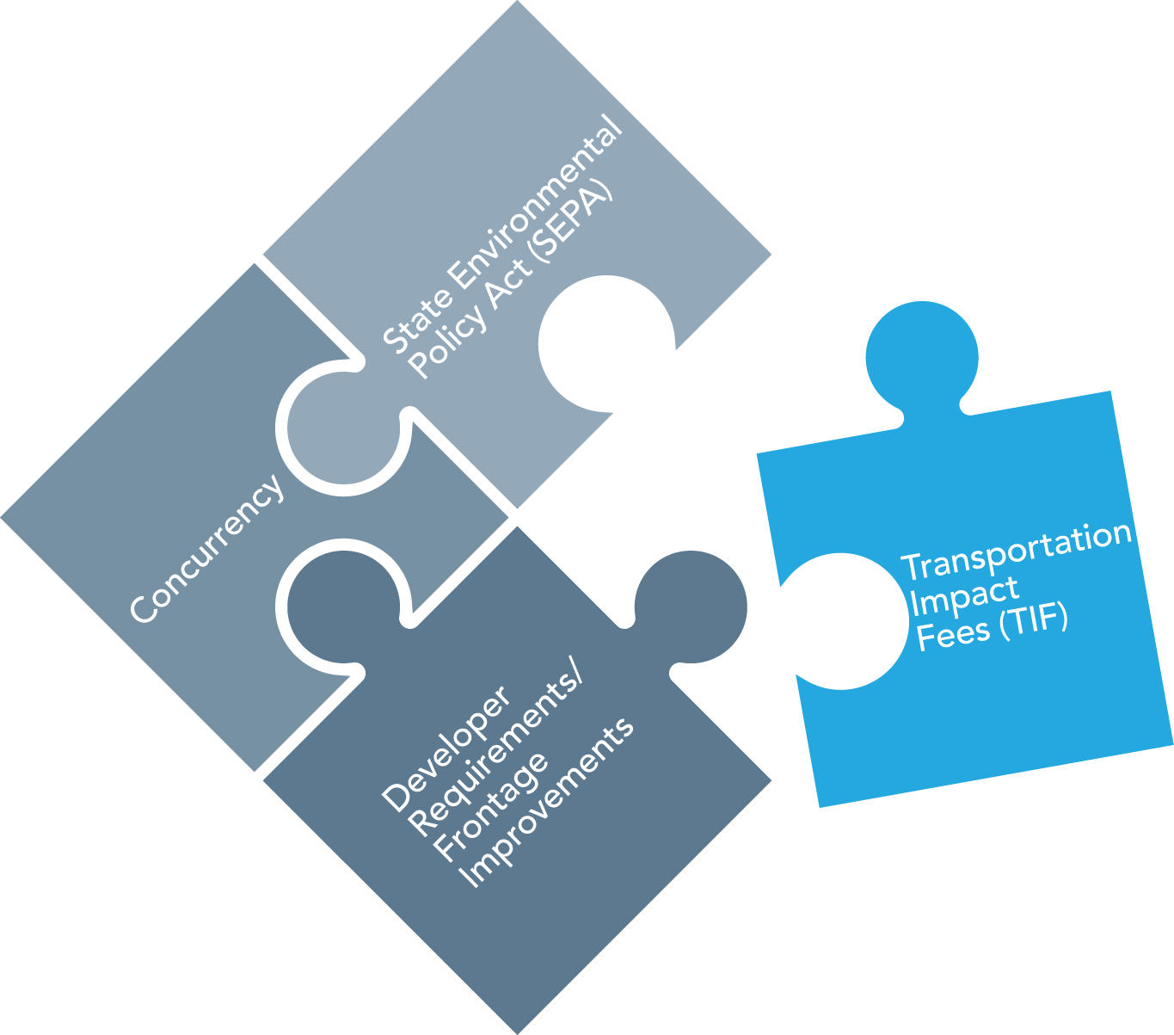
Development Review Elements
Funding Transportation System Improvements
Notes:
TIF is just one piece of the development review puzzle. There are four primary tools that agencies use in reviewing transportation system impacts for new development applications:
TIF
Optional GMA element
Addresses impacts to the “system”
Funding transportation system improvements
Concurrency
Required by GMA
Timing/adequacy of facilities concurrent with development impacts
Requires denial if development causes the level of service to decline below adopted standards
Can be implemented as part of SEPA or reviewed separately
Frontage Improvements
Project related infrastructure and on-site improvements.
SEPA
Reviewed on a development by development basis
Broad scope can be used to address capacity, safety, operations, non-motorized impacts, and transit
Uses “significant adverse impact” standard (not just level of service)
Does not require denial of developments if standards are not met

Slide 24
TIF Characteristics
Provide consistent framework for assessing developer mitigation
Allows developers to estimate potential traffic mitigation early in the process
TIF can be “pooled” to implement projects; pooling not generally allowed under SEPA
Funding can be better assured for capital projects – supports concurrency

Slide 25
Key Parts of TIF Program/Ordinance
Project list
Service area(s)
Rate schedule
Consideration of other studies
Credits for dedication of land or improvements
Impact fee account and annual report
Exemptions – broad public purposes
Notes:
Add photos about Sea-Tac airport (see 14041 project)

