Slide 1
APPRAISERS REVALUE PROPERTY EVERY YEAR
VALUES ARE ACCUMULATED FOR EACH TAXING DISTRICT AND WITHIN LEVY CODES WHICH ARE USED TO TRACK THE APPRAISED VALUE (SeaTac’s Physical Inspection was 2013 for 2014 taxes)
APPRAISERS ALSO PICK UP NEW CONSTRUCTION BASED ON PERMITS RECEIVED FROM THE CITIES OR FOUND IN THE FIELD
NEW CONSTRUCTION REPRESENTS ADDITIONAL, NEW REVENUE FOR TAXING DISTRICTS
THE NEW MONEY IS USED IN THE RATE CALCULATION FOR EACH DISTRICT’S PROPERTY TAX REVENUE

Slide 2
Appraisal Process
King County uses a 6-year inspection cycle for properties
Meaning: Appraisers physically visit each property in a designated area 1 time in 6 years. Otherwise, annual, statistical analysis is performed during the remaining 5 years
Both processes result in a property receiving a revaluation.
The two processes are:
Annual update - No Appraiser inspection unless there is a permit and statistical analysis is used to determine property value
Physical Inspection - Appraisers perform a visual inspection on property within a specified area and determine the property value

Slide 3
Appraisal Process
Both processes result in a new valuation for a property based on sales comparisons within the specific geographic location
A similar process is used for Condos, Apartments and Commercial properties except they rely more heavily on income methods to develop their value

Slide 4
Appraisal Process
The appraised market value is determined by the appraisers doing the area review.
However, this value may not be a taxable value!
The difference between market and taxable value is exempt value –
Most notably for residential property is: the senior citizen exemption.
Commercial property has: non-profits, churches or governmental ownership of property

Slide 5
RESIDENTIAL EXEMPTION PROGRAMS
Property Tax Exemptions remove market value from the tax rolls. For example:
Senior Citizen Tax Exemption RCW 84.36
(removes market value and seniors pay at a lower tax rate). Qualified Seniors do NOT pay on bonds-local schools and excess bonds make up the major portion)
Home Improvement Exemptions (removes new construction from remodels for 3 years) RCW 84.36
Current Use Program (farmland, openspace, timber/forest properties) RCW 84.33 and 84.34
Destroyed Property (fire or flood damaged property) RCW 84.70

Slide 6
COMMERCIAL EXEMPTION PROGRAMS
COMMERCIAL EXEMPTIONS ALTER HOW TAX DOLLARS ARE USED AS WELL AS REMOVE VALUE FROM THE TAX ROLL
EXAMPLES OF COMMERCIAL EXEMPTION PROGRAMS ARE:
NON-PROFIT/GOVT OR CHURCH-OWNED PROPERTIES (RCW 84.36)
HISTORIC PROPERTY (RCW 84.26)
LOCAL INFRASTRUCTURE FINANCING TOOL (LIFT) (RCW 39.102)
LOCAL INFRASTRUCTURE PROJECT AREA (LIPA) (RCW 39.108)
MULTI-FAMILY HOUSING EXEMPTION (MFTE) (RCW 84.14)

Slide 7
LEVY CODES
ALL ASSESSED VALUE IS TRACKED USING LEVY CODES.
THEY ARE UNIQUE IDENTIFIERS ESTABLISHED TO PROPERLY CALCULATE, COLLECT AND DISTRIBUTE TAXES
A LEVY CODE REPRESENTS A UNIQUE COMBINATION OF ONE OR MORE TAXING DISTRICTS
EVERY PARCEL IS ASSIGNED A SPECIFIC LEVY CODE DEPENDING ON ITS LOCATION WITHIN THE DISTRICTS’ BOUNDARIES
PERSONAL PROPERTY ACCOUNTS ALSO HAVE LEVY CODES ASSIGNED TO THEM BASED ON WHERE THE AFFILIATED BUSINESS IS PHYSICALLY LOCATED

Slide 8
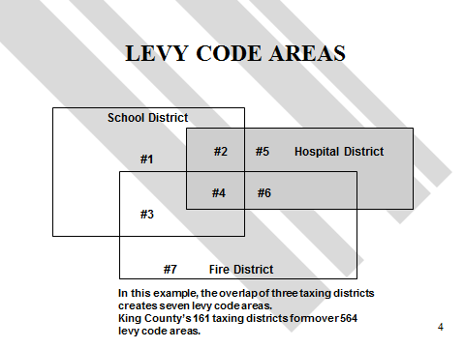

Slide 9
SeaTac Levy Codes
SeaTac has 21 different levy codes.
One reason for the different codes is the meandering boundaries of 4 different school districts that service the city – Highline, Renton, Tukwila and Kent
Part but not all of the City is also serviced by Hospital District #1.

Slide 10
LEVY/CERTIFICATION PROCESS
Once the valuation process is completed, we must determine how much TAXABLE value is within the district’s boundaries
This occurs towards the end of November after we receive the State Utility Values which are also added into the district’s value total.
The districts start to send us their budget requests.
We start developing preliminary levy rates

Slide 11
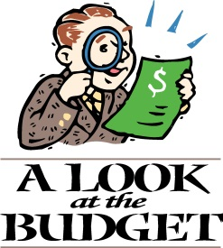
Budget/Rate Calculation
We calculate the 101% levy limit worksheets for each taxing district and calculate their allowable levy amount.
The calculation is:
A district may receive 1% over last year’s allowable
budget.
So, 1.01 x last year’s budget request (which is generally
the highest lawful levy since 1985) equals the new allowable budget.
We also add new construction, annexation value, lid lifts and refund fund amounts in the calculation for a new allowable budget and levy rate.
We also perform additional limiting calculations such as
the $5.90 and 1% constitutional limit check and determine if
prorating will be necessary.

Slide 12
$5.90 Check
Once we have determined each district’s rate, we perform an additional check on each levy code (unique combination of districts) to determine if any exceed the $5.90 limitation.
The 5.90 check is for EXPENSE RATES ONLY and includes:
County, Road, City, Fire, Library, Hospital Metro Parks, Cemetery and other Junior taxing districts
This would be where junior districts would be prorated if the $5.90 is exceeded.

Slide 13
1% Check
The 1% levy rate check is performed next.
It includes all the $5.90 districts and adds the State Levy. If the levy exceeds the 1% ($10.00 adjusted maximum), prorating would occur among the junior taxing district.
At this point, we are finally ready to submit the rates and print the tax bills.
Tax payments are due 4/30 and 10/31 and they are distributed to the taxing districts.

Slide 14
Questions?

