Slide 1
Economic Development Project Showcase : Reserve at SeaTac
City Council Presentation
March 8, 2016

Slide 2
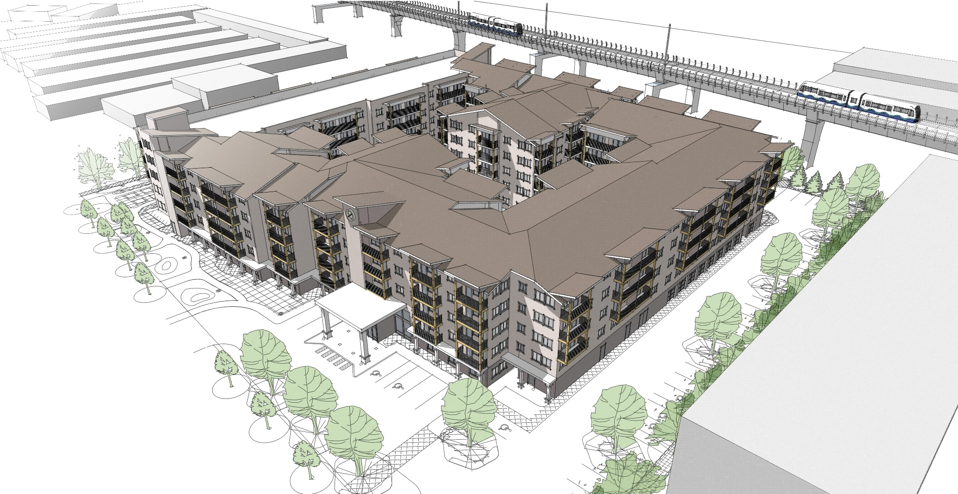
Reserve at SeaTac

Slide 3
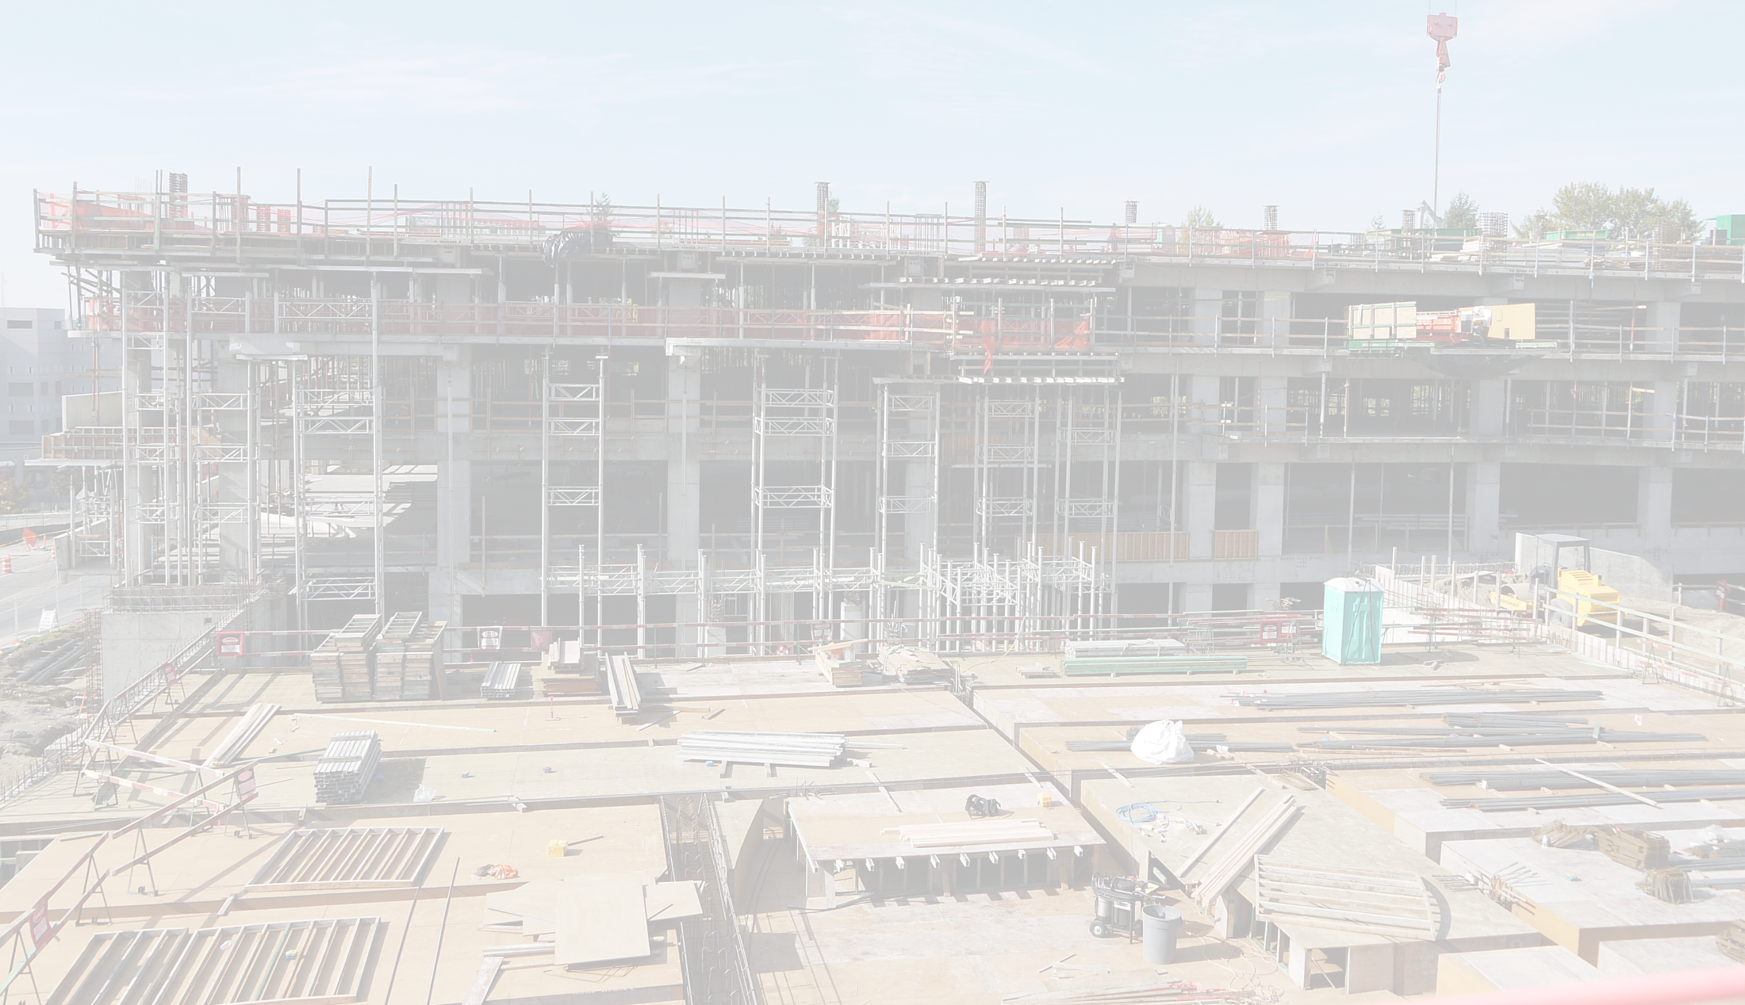
Reserve at SeaTac
Project Timeline:
Initial contact with real estate broker | May, 2014
Technical assistance | June – July, 2014
Pre-application meeting #1 | August, 2014
Permit submittal | December, 2014
Permit issuance | May, 2015
Projected completion | November, 2016

Slide 4
Reserve at SeaTac
Project Type: 289-unit Affordable Senior Apartments
Site Size: 2.86 Acres
Previous Land Use: Rental Car Lot
Development Timeline: March 2015 - Oct. 2016
Construction Cost: $25 million

Slide 5
Reserve at SeaTac
Project Impetus
Location
Grayfield site
Mid-sized city
Size of site
Market Demand for affordable senior housing

Slide 6
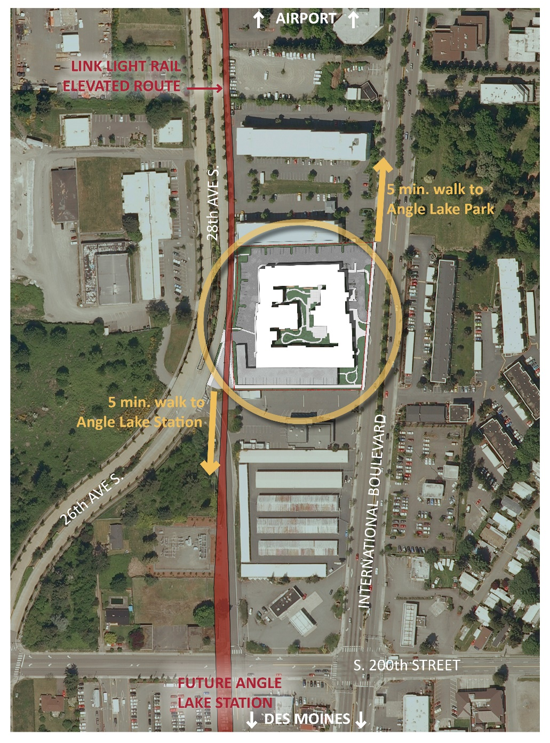
Reserve at SeaTac
Project Location
Proximity to transit
Future Angle Lake Station
Rapid Ride
Proximity to amenities
Shopping
Recreation
Favorable zoning

Slide 7
Reserve at SeaTac
Impact on Surrounding Community
Provides housing
Support for high capacity transit
Encourages activity at the street level

Slide 8
Reserve at SeaTac
Local Jurisdiction Support
Strong support from the outset, quick reviews & permitting
Ongoing working relationship
City “on our side” – works with us to negotiate with other agencies, find solutions

Slide 9
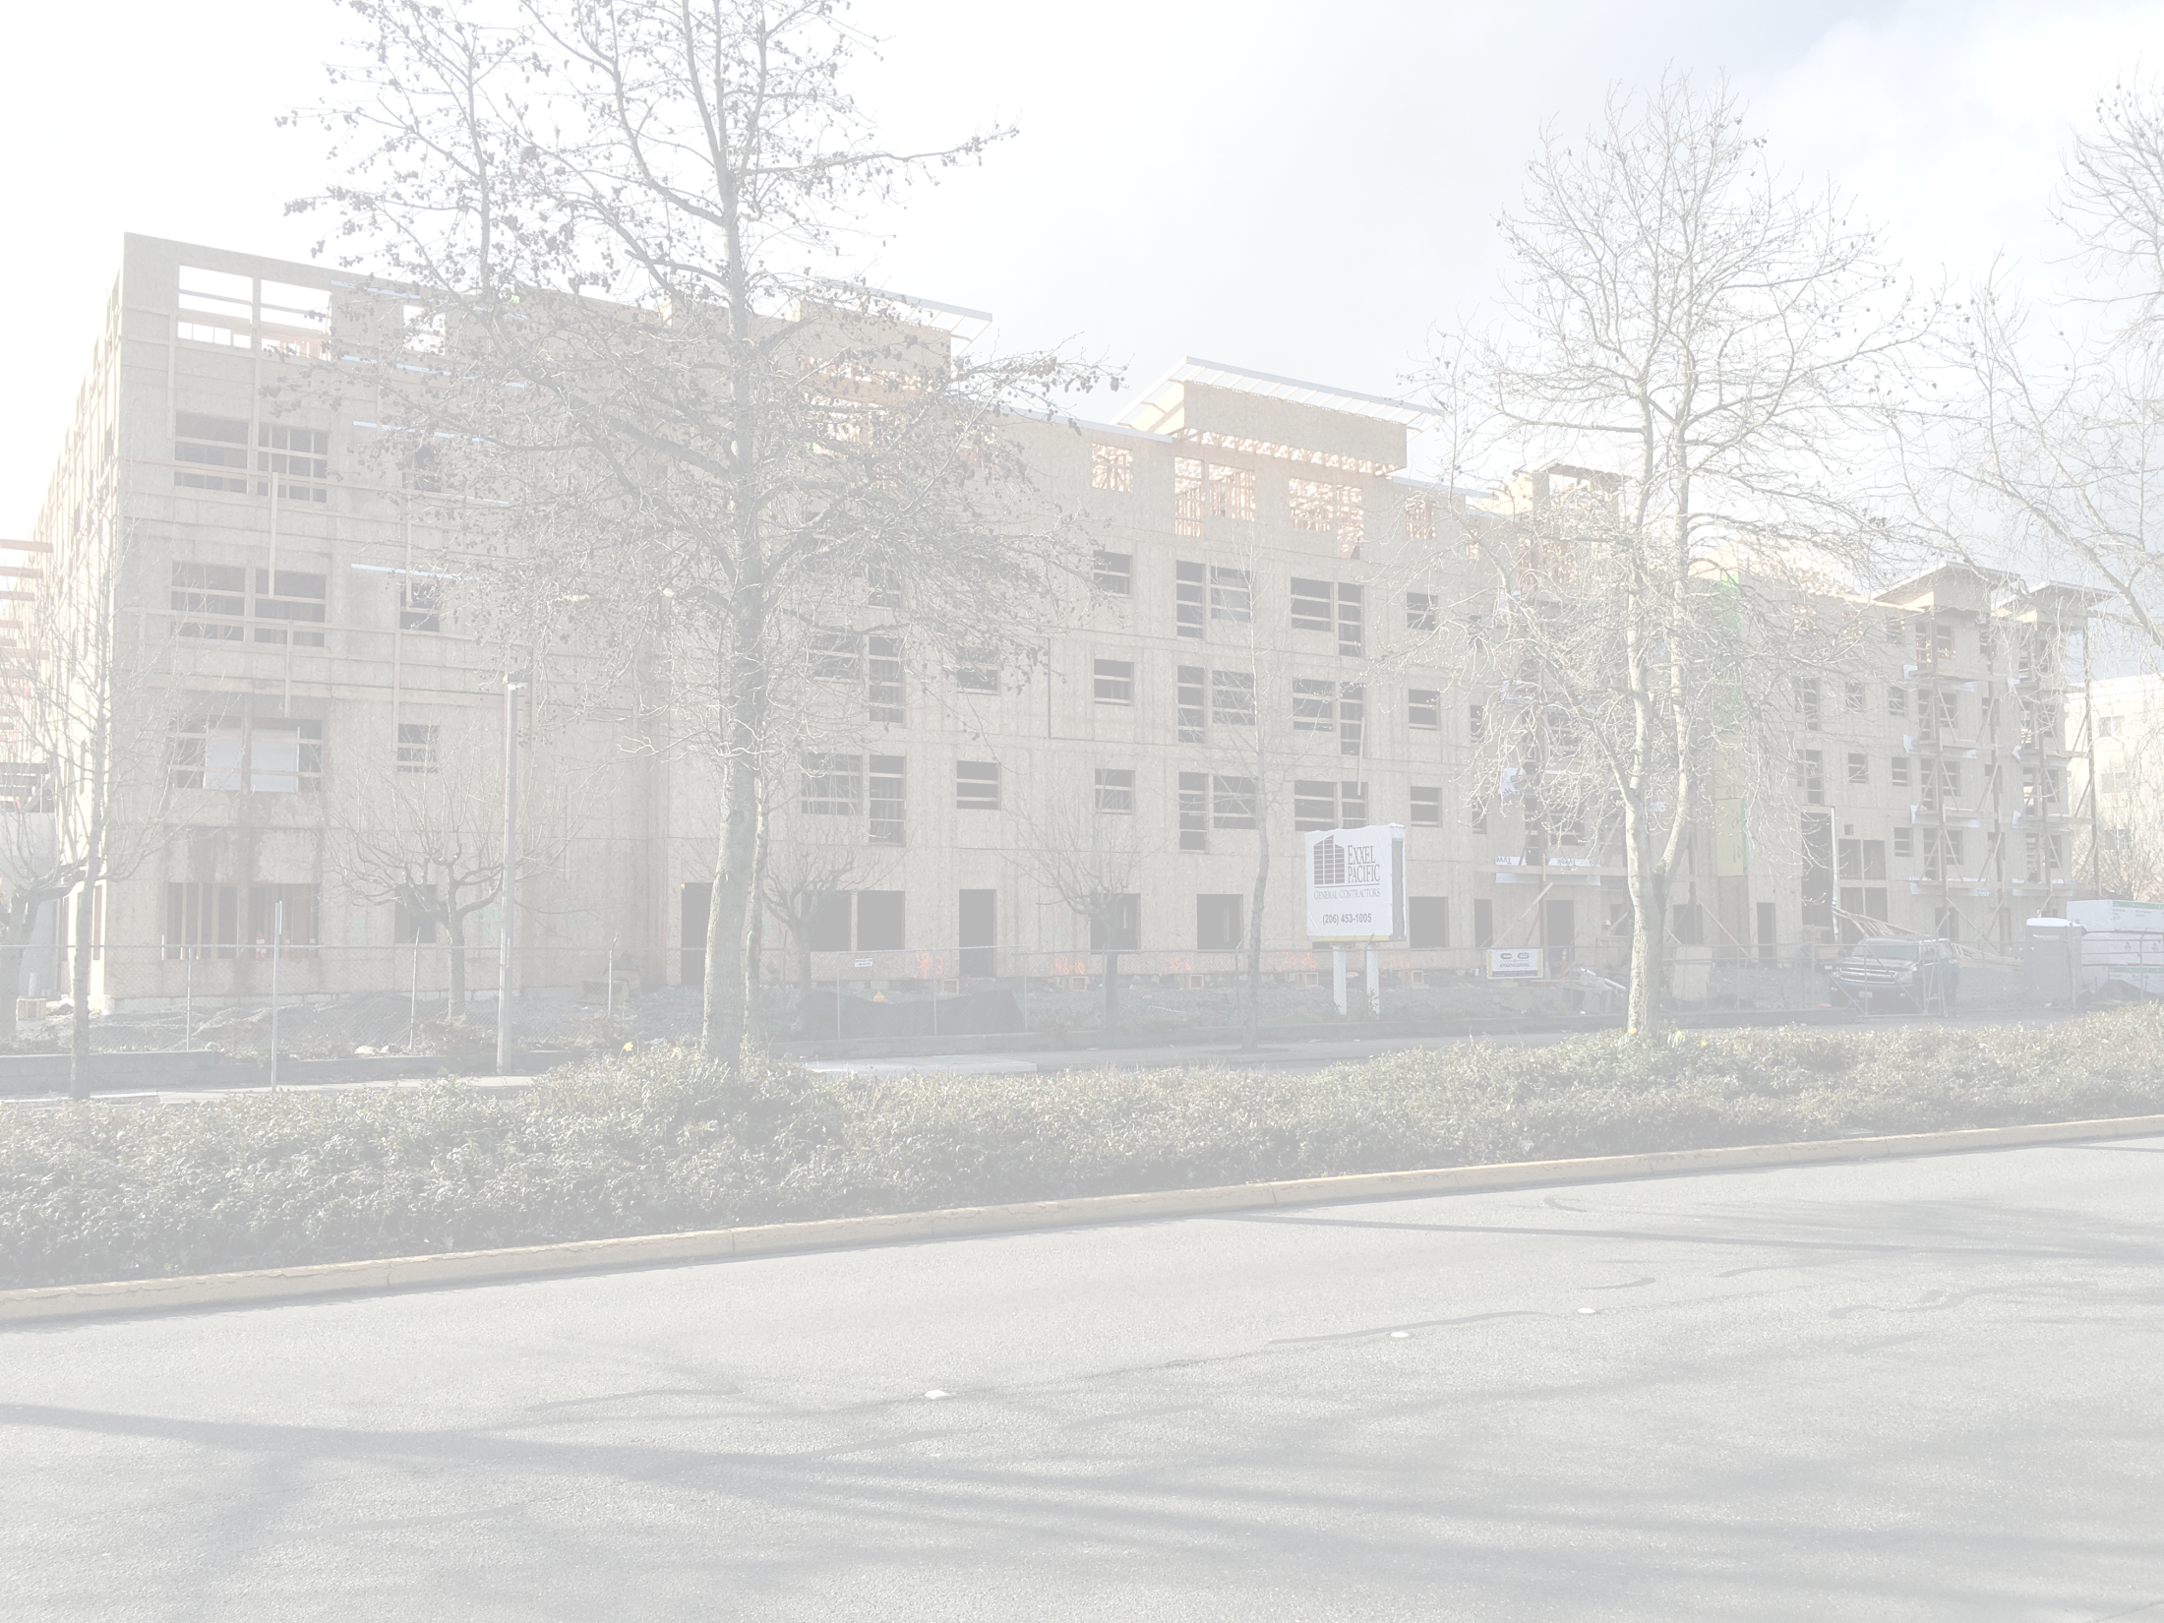
Reserve at SeaTac
Project-Related Budget Revenue for City:
Building Permit Fees | $251,445
Construction Sales Tax | $212,500
Transportation Impact Fees | $ 10,945
Real Estate Excise Taxes | $ 26,500
TOTAL One Time Revenue: | $501,390
Estimated Annual Property Tax* $101,041
Based on estimated valuation of $32,000,000. An increase in valuation of $26.6 million over the prior use as a rental car facility.

Slide 10
Questions?

