Slide 1
Interlocal Agreement Land Use Issues
City Council Study Session
December 22, 2015

Slide 2
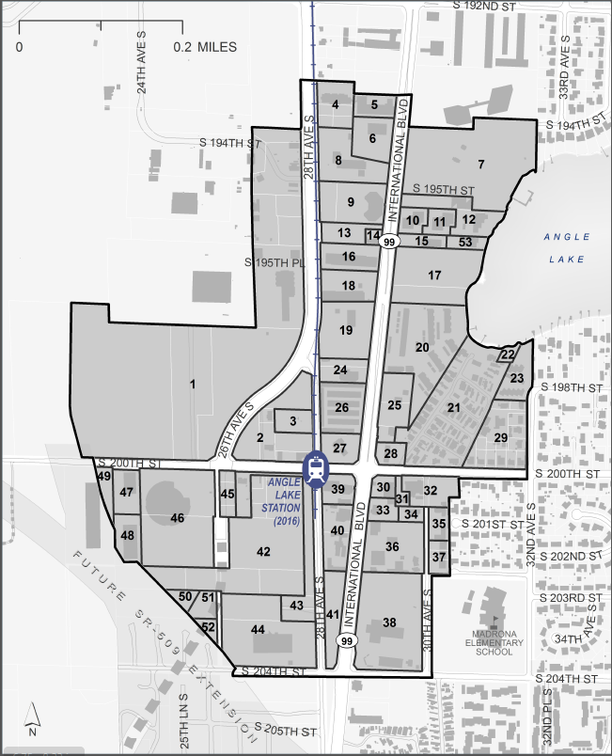

Slide 3
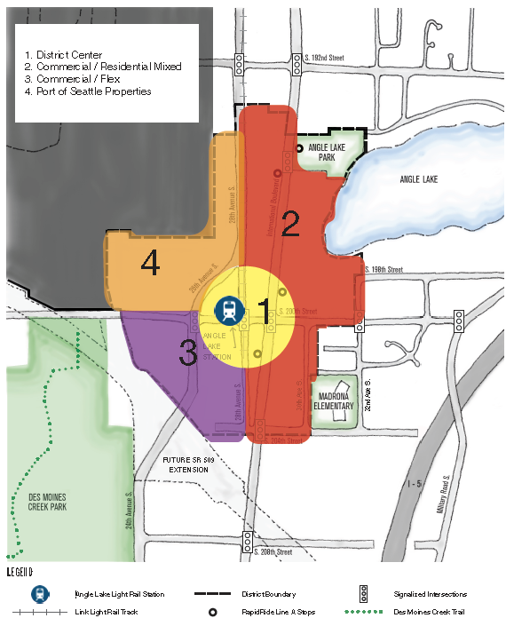

Slide 4
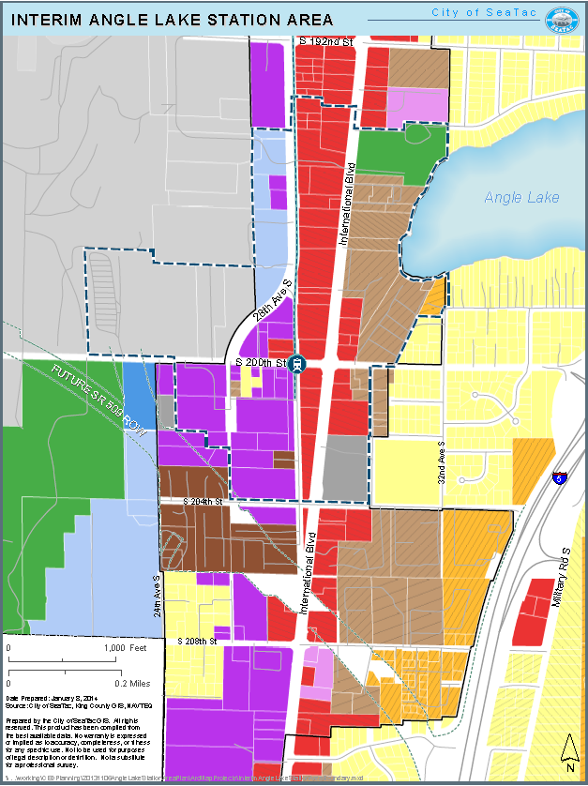

Slide 5
Land Use issues under the Interlocal Agreement (ILA)
ILA addresses use of Port property for airport operations and for non-airport purposes
Land use issues primarily within the Cover Memo and Exhibit A.
ILA provides City with more involvement and advance notice/input in the environmental and development processes than we would be entitled to without the ILA.

Slide 6
With the ILA in place (existing/extended)
ILA recognizes by mutual agreement the Port’s and the City’s separate authorities over the development of the airport and non-airport properties and establishes processes where those authorities may overlap or may be disputed.
Existing adopted Airport Master Plan document (1997 and 2005) and the City’s Comprehensive Plan govern land use
The process for the Port’s conversion of lands from non-aviation (AVC zone) to aviation operations (AVO zone)
Allowance for site specific development agreements
A “no surprises clause” and joint consultation to deal with new properties not covered in the existing documents
A dispute resolution process (mutual agreement rather than litigation)
Advanced consultation and consideration of comments and potential mitigation measures in SEPA/NEPA environmental determinations

Slide 7
Without the ILA in place (expires)
The Port and the City would retain their separate authorities over the development and operation of aviation operations and non-airport properties. Areas where those authorities may overlap or be disputed would remain
City’s Comprehensive Plan, Zoning and other development codes would apply
Port would be able to propose any project whether in Airport Master Plan or not
City would review plans, issue permits, assess traffic impact fees, inspect construction (non-discretionary)
City may not be entitled to advance input on SEPA/NEPA documents and determinations
City could comment during the standard public comment periods and could file appeals

Slide 8
Without the ILA in place (expires) - cont
Port would retain existing authority to develop and adopt the SAMP
Port would not have any contractual obligation to consult with the City prior to adoption and implementation of the SAMP
No requirement to disclose proposed actions early; there would be “surprises”
No requirements for joint consultation on new or expanded projects
Streamlined processes and other mutually agreed upon provisions in ILA would not exist
Disputes over the legal authorities would be more likely to end up in appeals and/or litigation

Slide 9
Comments & Questions

