Slide 1
Code Compliance Update
City Council Study Session
January 26, 2016

Slide 2
City Council Goal
In order to enhance quality of life and public image, enhance code compliance effectiveness within all neighborhoods and areas in the city.

Slide 3
Staffing issues
One Code Compliance Program Coordinator position currently vacant
Part-time Administrative Assistance position currently vacant; temp agency staff being used
Complaints continue to be received at typical rate (21 YTD through 1/22/16 )

Slide 4
Abatements
2016 budget was amended to add $48,000 of funding for abatements
Abatement policy and implementation procedure is being finalized
Initial two sites targeted for abatement may soon be resolved by property owners

Slide 5
2015 Total and 4th Qtr.
Code Compliance Activities
Total 4th Qtr.
New Cases 379 56
Closed Cases 422 59
Active Cases 111 111
CONFIRMED CODE VIOLATIONS
Junk 64
Vegetation 11
Vehicles 28
Vacant Structure 2
Graffiti 2
Rodent Harborage/Infestation 1

Slide 6
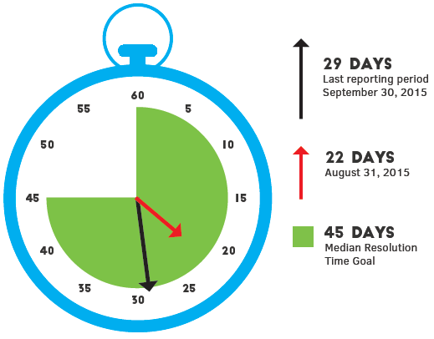
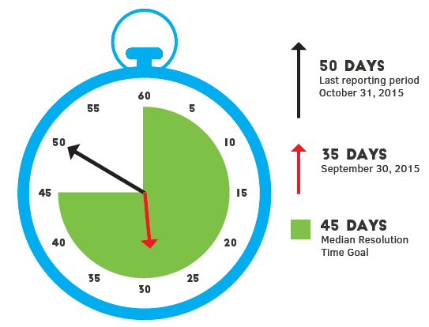
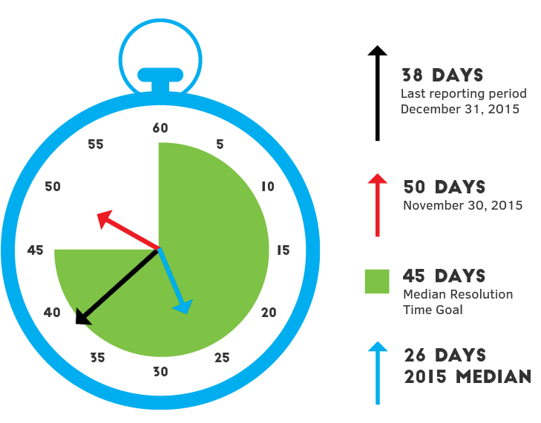
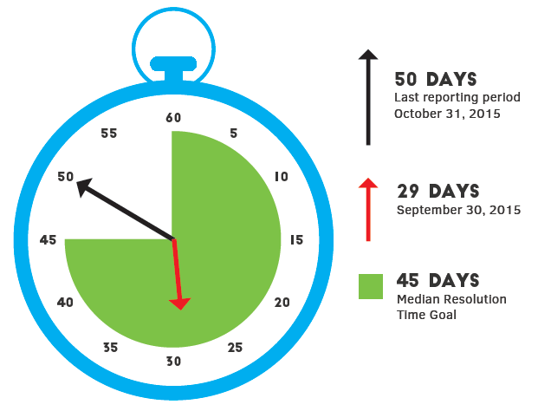
Dashboard/performance measures
Median Resolution Time / Code Compliance Stopwatch (measured in days)
October
November
December
Also measuring time from receipt of complaint to initial site inspection
(target is 3 days; currently achieving 2 days)

Slide 7
Comments & Questions

